Slide 1
Finding literature
Search strategy
Sources of information
Applying your search strategy
Notes:
Take some time to think about your search strategy.
Consider the sources you will use and apply your strategy.

Slide 2
Literature Searching
Define your topic - produce a list of keywords and phrases which you could use as search terms
Identify potential sources of information
Search selected resources - DiscoverEd, bibliographic databases, relevant websites, organisations etc
Evaluate the information recovered
Organise, apply and communicate the information - cite references, consider using bibliographic reference management software

Slide 3
Think about the information you need – why?
It does not have to be everything published on the topic. Select the literature.
Reverse engineer from ideal data.
Get ideas for your search terms by looking at prior reviews and known relevant studies.

Slide 4
What keywords will you use in your search?
Identify the concepts
Think of the relevant terms for each concept
Think of alternative words, spelling, acronyms, broader and narrower terms
Get ideas for your search terms by looking at known relevant studies
Any limits/what you don’t need to read about?
Record your strategy

Slide 5
Some ways to help improve your search
Truncation: allows you to search for variations optic* for optic, optics or optical
Phrase: helps retrieve more relevant results
“distributed systems”
Boolean: AND, OR, NOT
Notes:
5
5

Slide 6
Sources of Information
Make a strategic selection of literature databases, websites and expert contacts
Google Scholar
Relevant websites, oganisations, blogs …
The library
DiscoverEd – books, book chapters, journal articles
Databases
Standards and Patents (if relevant)
A recommended article can be a good start

Slide 7
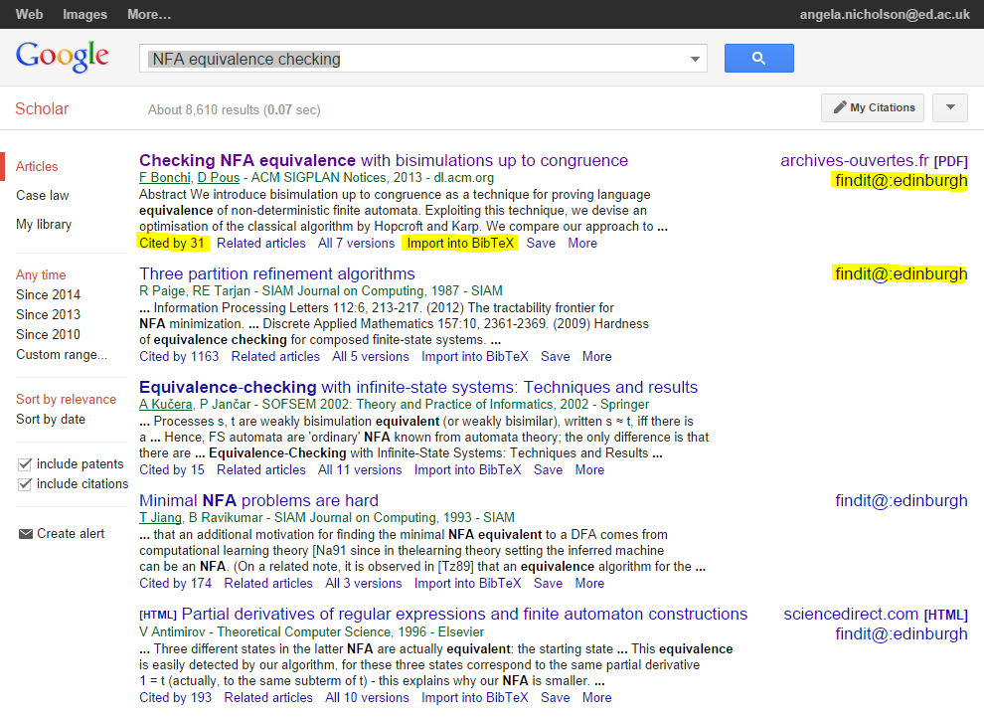
Google Scholar
A good place to start a search but not always the place to stop

Slide 8
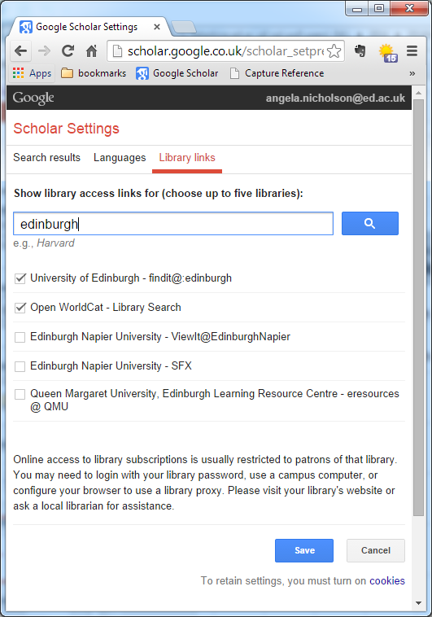
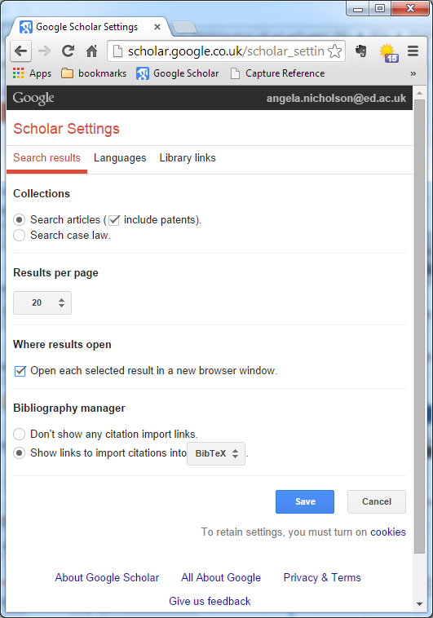
Google Scholar. Settings can help you – Findit@Edinburgh ,import to bibliography manager
Notes:
If you haven’t already look at the options available and how they may help you

Slide 9
DiscoverEd
Allows searches across a major selection of our resources
Results are peer reviewed and academic
You don’t have to know where to look
Bear in mind
Not exhaustive but can indicate potentially useful sources
Notes:
9

Slide 10
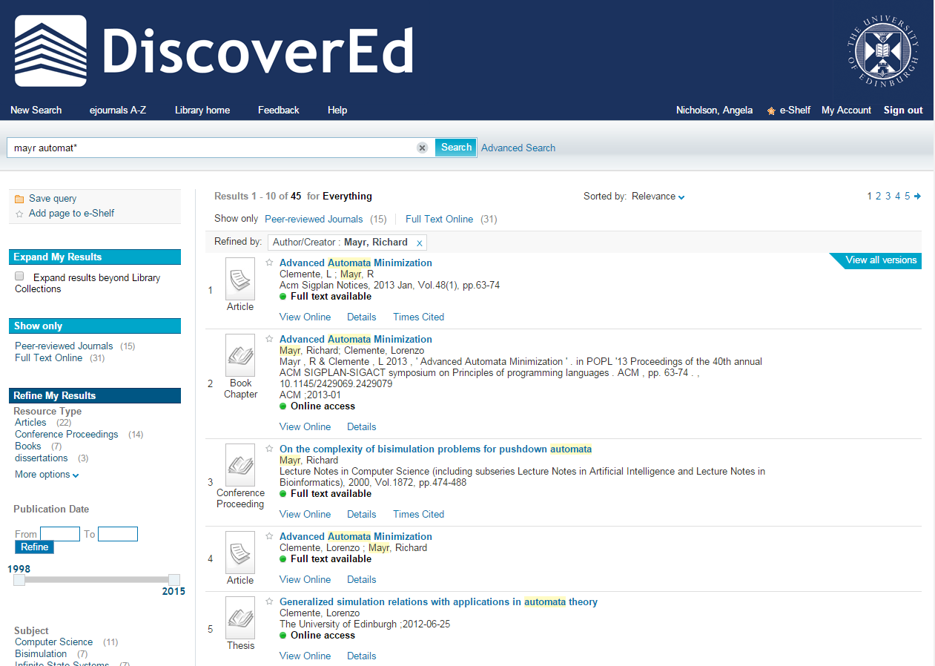
Sign in
Notes:
10
10

Slide 11
Bibliographic databases
Contain information about the contents of a range of academic publications (abstracts, journal articles, book chapters, reports etc)
Search details of millions of articles to find what publications exist - even if not held in our library
Can be subject specific
Can use sophisticated searches

Slide 12
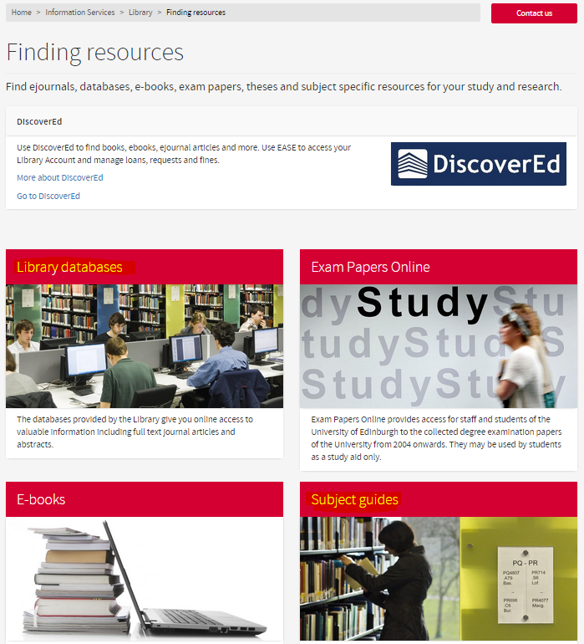
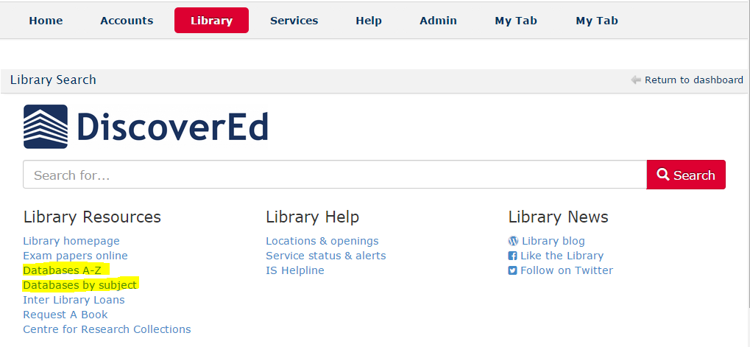
Databases Search by A-Z or subject list

Slide 13
Bibliographic Database
Web of Science Core Collection
Scopus
ACM Digital Library
IEEE/IEE Electronic Library
Inspec
…
Other Sources
ArXiv.org – open access to e-prints in Physics, Mathematics, Computer Science
CoRR The Computing Research Repository - online repository. Full-text articles
CiteSeerX
DBLP
Notes:
Sources selected depend on your topic
Web of Science/Scopus are broad general sources.
Others are more focused on computing science and offer some sophisticated features

Slide 14
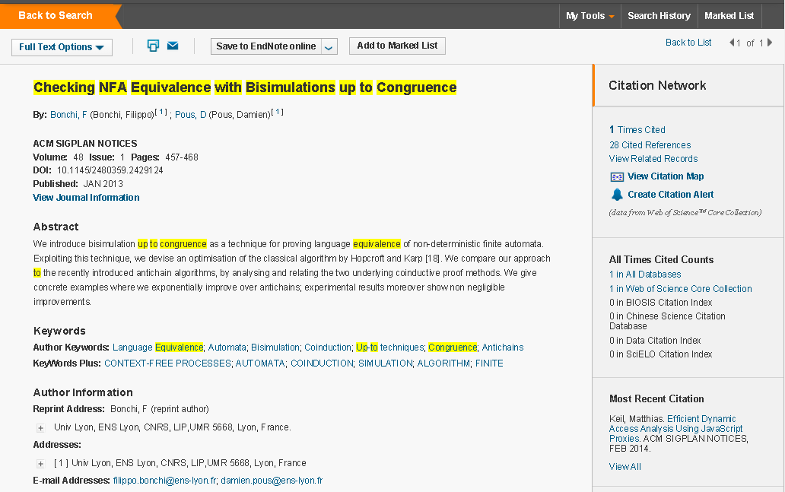
Notes:
From this result you can link to the full article.
Also to the references and to other works that have cited this article since publication.
Keywords – may be useful to help refine your own search.
Keywords – select the link to see related articles in the Web of Science Core Collection.

Slide 15
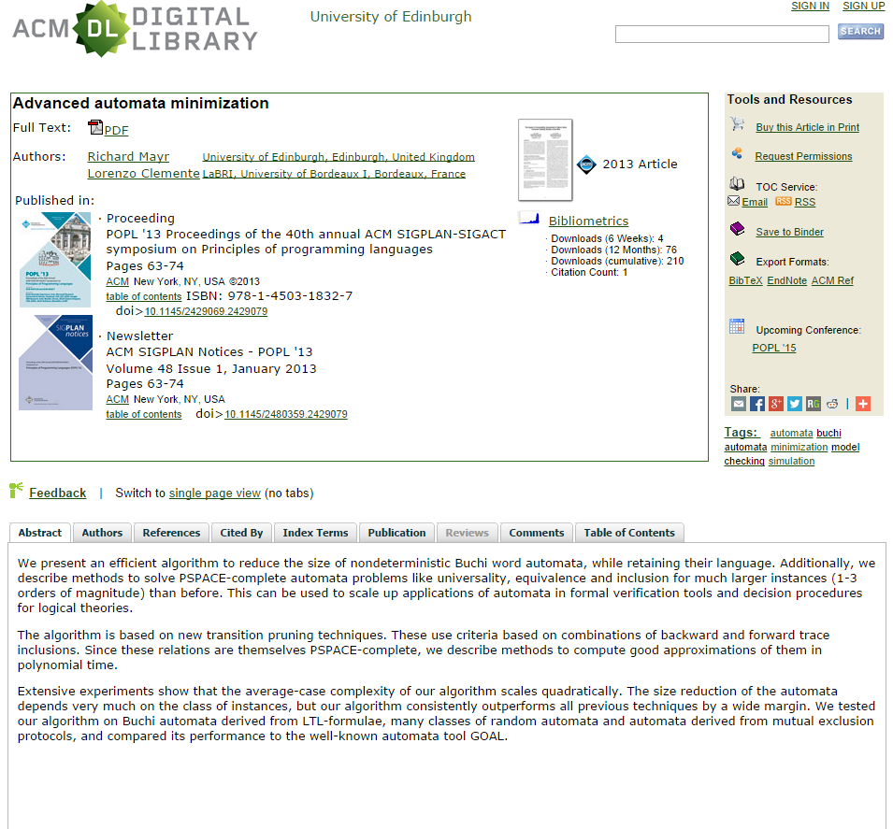
Notes:
[ACM]
Can also link to the article and to related articles via ‘Index Terms’

Slide 16
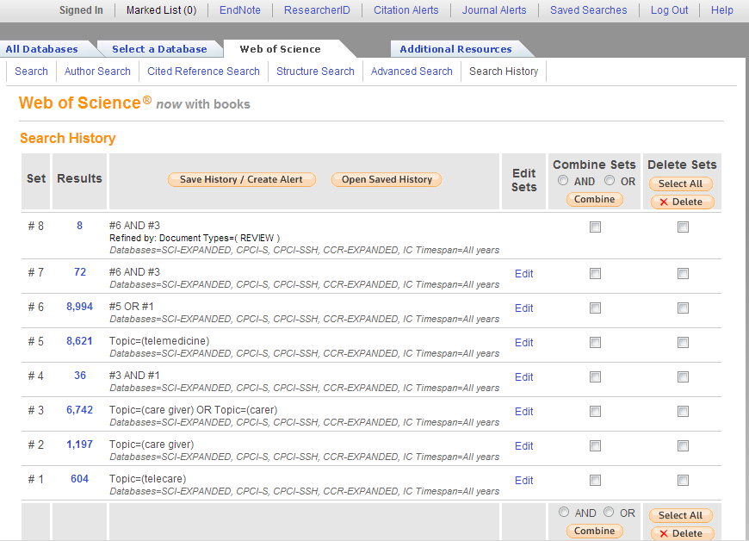
Create an account to save searches and manipulate them later
Notes:
You can build up a search and refine it
You can save it and go back to it later

Slide 17
Evaluate your results
Currency - is there a date attached? Does it matter?
Relevancy - how close a fit is it to your search strategy/inclusion criteria?
Accuracy - is there information included which you know is inaccurate?
Authority - do you trust the author of the information?
Objectivity - is there bias?

Slide 18
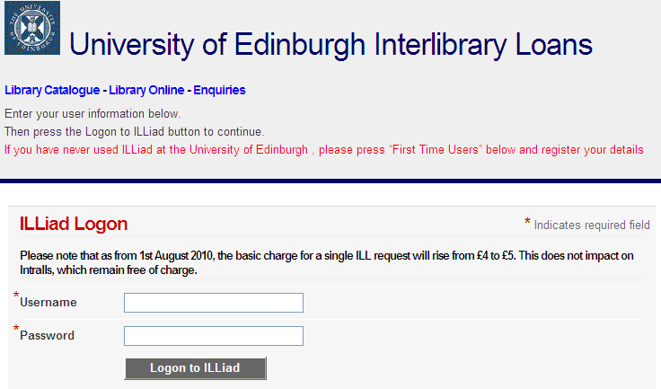
If it’s not available … www.ed.ac.uk/is/library-resources-plus
Notes:
Inter-library loans.

Slide 19
Summary
Think about your search strategy
Use available resources
Refine your search
Save your results/searches
Remember to cite the references you use appropriately
Help
www.ed.ac.uk/is/library and from library staff
IS.Helpline@ed.ac.uk
Angela.Nicholson@ed.ac.uk, Tel: 51 5123

