Slide 1
Our “Handbook” webpages
The IGS Intranet webpages are our version of a Student Handbook – they have a lot of information and guidance in them…..please take time to look at the information!
Timelines to help guide your progress milestones
Processes for making changes to programmes (e.g. interruptions etc)
Annual Review guidance
Training courses
Information on funding
Etc etc
Notes:
During your PGR programme, you are governed by the Research Degree Programme Regulations and will be examined under the guidance of the PGR Examination Regulations. When you complete the matriculation process, you are agreeing to be governed by these regulations, therefore, it is
recommended that you read these documents to understand what is expected of you during the
course of your PGR programme.
Degree Regulations and Programme of Study Postgraduate Degree Programme Regulations
2020/21 are here: http://www.drps.ed.ac.uk/20-21/regulations/PGDRPS2020-21.pdf
PGR Examination Regulations are here:
https://www.ed.ac.uk/files/atoms/files/2020_postgraduateresearch.pdf
CDT students will also be provided with a CDT Programme Handbook, which will document any
conditions related to academic progression and continuation of funding. These will be provided to
students by the CDT Coordinators/Administrators.

Slide 2
Becoming Fully Matriculated
You must have a status of “fully matriculated” before we can pay you your stipends
Registration (all)
Confirmation of attendance (all) – in person for new students, the IGS office is open (if you are not here, you must have an approved LoA in your EUCLID student record….)
International check in (if applicable)
Student Immigration Service and International check-in
Student Immigration Service here to help with all queries/issues relating to student immigration
All new students sponsored on a student visa (or other relevant visa) must complete the international check-in process once they are in the UK. This is an in-person process and you need to book an appointment if you haven’t already.
Matriculating and confirming attendance is a YEARLY admin task
If you fail to matriculate and confirm attendance each year, you will be withdrawn from your programme.
Reminders will be sent by IGS team; expect to have to visit the office in person at the appropriate time each year.
Notes:
During your PGR programme, you are governed by the Research Degree Programme Regulations and will be examined under the guidance of the PGR Examination Regulations. When you complete the matriculation process, you are agreeing to be governed by these regulations, therefore, it is
recommended that you read these documents to understand what is expected of you during the
course of your PGR programme.
Degree Regulations and Programme of Study Postgraduate Degree Programme Regulations
2020/21 are here: http://www.drps.ed.ac.uk/20-21/regulations/PGDRPS2020-21.pdf
PGR Examination Regulations are here:
https://www.ed.ac.uk/files/atoms/files/2020_postgraduateresearch.pdf
CDT students will also be provided with a CDT Programme Handbook, which will document any
conditions related to academic progression and continuation of funding. These will be provided to
students by the CDT Coordinators/Administrators.

Slide 3
Stipend payment process
You submit your completed and signed UK bank account info via the F98 form to Margaret in IGS → once you are fully matriculated, Margaret will submit a P&M student supplier number and stipend payment request to the University’s Central Scholarships Payment Team (note that IGS staff are unable to process payments themselves)
Central Finance team then process an upfront bulk stipend payment (which is the first payment and covers the first 3 months of your funded period).
Once the request has been made, it may take up to 10 working days for the payment to be processed, but once processed, funds should arrive in your bank account within 5 working days.
The Central Scholarships Payment Team will be dealing with approximately 2500 new stipend payment requests in the month of September….please be patient!
After the bulk payment, your regular (advanced) monthly payments will commence from month 4 onwards.
For those starting on 11 Sept, your first monthly payment will be around 28 Nov (for Dec).
For those starting 2 Oct, your first monthly payment will be around 21 Dec (for Jan).
Anyone already in a positon of genuine financial difficulty/hardship should (confidentially) raise this with the IGS on submission of their F98 form so that we can ask the Central Scholarships Payment Team for the first payment to be prioritised.
Notes:
During your PGR programme, you are governed by the Research Degree Programme Regulations and will be examined under the guidance of the PGR Examination Regulations. When you complete the matriculation process, you are agreeing to be governed by these regulations, therefore, it is
recommended that you read these documents to understand what is expected of you during the
course of your PGR programme.
Degree Regulations and Programme of Study Postgraduate Degree Programme Regulations
2020/21 are here: http://www.drps.ed.ac.uk/20-21/regulations/PGDRPS2020-21.pdf
PGR Examination Regulations are here:
https://www.ed.ac.uk/files/atoms/files/2020_postgraduateresearch.pdf
CDT students will also be provided with a CDT Programme Handbook, which will document any
conditions related to academic progression and continuation of funding. These will be provided to
students by the CDT Coordinators/Administrators.

Slide 4
Building Inductions, Office access and keys
Building access, desks and collecting equipment
Building accesses – Informatics Forum, Bayes and Wilkie
The Informatics Forum, Bayes Centre and Wilkie make up the Informatics estate and you will be required to complete the necessary building inductions before swipe card access will be added to your student card.
A shared office will be allocated to you on completion of the building induction and once you have paid a £20 refundable deposit though the key deposit is not required for all offices.
Computing Equipment
All new PhD students will be sent a computing request form, where you will advise IGS of what computing equipment you require. Standard provision is issue of a laptop, to facilitate shared space provision and allow flexible working between office / home / other University study spaces.
Collection of School laptops will be from the IGS office (though CDT students will have alternative arrangements).
The School’s Computing Support team have created a LEARN course for all new students to help you familiarise yourself with using Informatics equipment and systems (information on how to access this will be provided on collection of the equipment)
Notes:
During your PGR programme, you are governed by the Research Degree Programme Regulations and will be examined under the guidance of the PGR Examination Regulations. When you complete the matriculation process, you are agreeing to be governed by these regulations, therefore, it is
recommended that you read these documents to understand what is expected of you during the
course of your PGR programme.
Degree Regulations and Programme of Study Postgraduate Degree Programme Regulations
2020/21 are here: http://www.drps.ed.ac.uk/20-21/regulations/PGDRPS2020-21.pdf
PGR Examination Regulations are here:
https://www.ed.ac.uk/files/atoms/files/2020_postgraduateresearch.pdf
CDT students will also be provided with a CDT Programme Handbook, which will document any
conditions related to academic progression and continuation of funding. These will be provided to
students by the CDT Coordinators/Administrators.

Slide 5
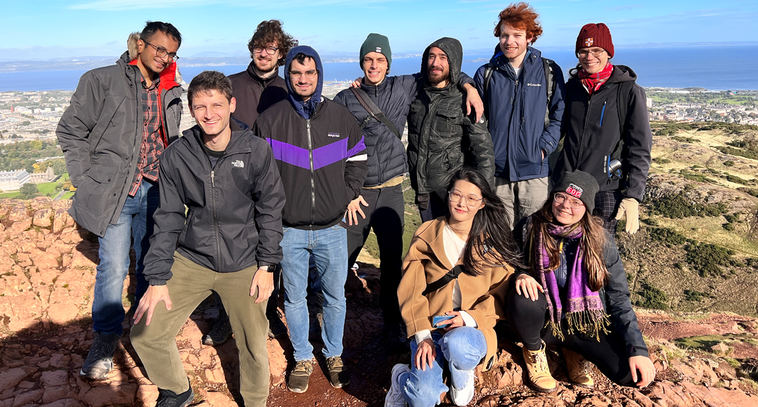
PGR Community and Social Events
PGR First Year Social Events
First Year Board Games (and pizza!) Night
Student organiser
DATE / LOCATION
Arthur Seat Walk
Student organiser
DATE / MEETING LOCATION
First Year Art Space Session
Student organiser
DATE / LOCATION
Upcoming events / future plans
School budget to fund PGR community and social events (approx. £17k for 23/24)
Monthly PGR Coffee mornings
Annual Summer BBQ
Firbush and Fox lake activity adventure days
Ad hoc, student-led events → please submit ideas when invited, we can’t do this without you!

Slide 6
Words of wisdom…
Regularly (at least weekly) check your University of Edinburgh email account – it is the only email address we will use in relation to University business.
Be proactive in submitting concession requests (ideally at least a month to six weeks) → we need time to process and seek approvals and last minute requests causes unnecessary stress for the admin team.
If you don’t receive a monthly stipend payment as expected (it should be in tour account no later than 28th of the month), contact IGS@ed.ac.uk and we will resolve the issue promptly.
If you receive a tuition fee invoice when you shouldn’t, do not ignore it, contact the IGS@inf.ed.ac.uk and we will resolve the issue promptly.
Finally, get involved with PGR events and initiatives → a vibrant, happy community is only possible if you join in, get involved and show your support.

