Slide 1
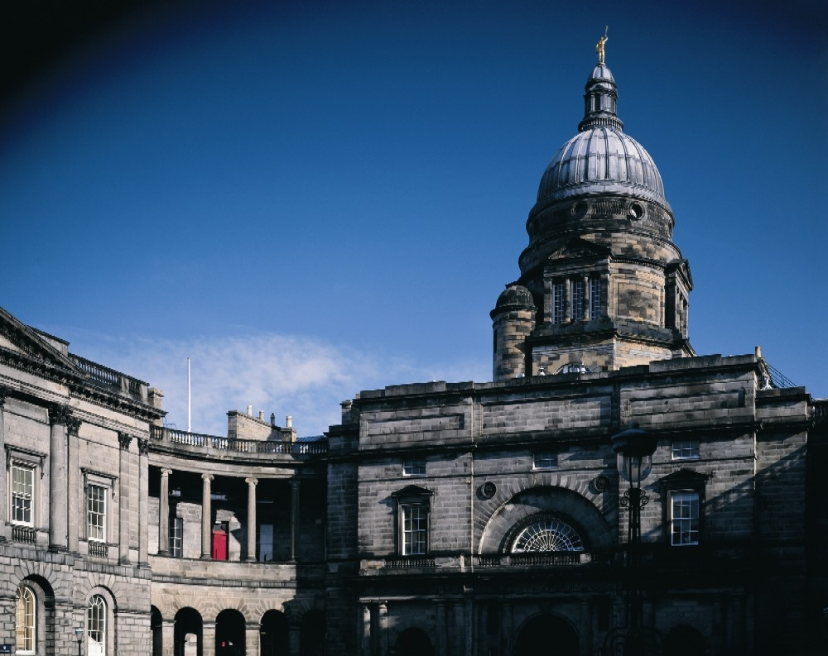
Research Support Office
Asad Nazir – Asad.Nazir@ed.ac.uk

Slide 2
Outline
An Introduction to RSO
Application Process and Support available
Research Funding Applications
Opportunities for Early Career Researchers

Slide 3
Research Support Office
Research Development
Research Support
EU Team
Contracts Office (Studentships, MTAs)
Strategic Research Initiative Team

Slide 4
RSO: Research Development
Aims to encourage research funding application activity
Promote funding opportunities
Arrange funder visits
Run workshops, Learning Lunches, Networking events
Resources:
Website http://www.ed.ac.uk/research-support-office
Blog http://www.blog.rso.ed.ac.uk/
Research Professional http://www.researchprofessional.com/

Slide 5
Proposal Support available
Funder Information
RSO Website: https://www.ed.ac.uk/research-support-office/funders-and-funding
Research Professional: https://www.edweb.ed.ac.uk/research-support-office/funders-and-funding/research-professional
Dossier of Previously Successful applications
RSO Website: https://www.edweb.ed.ac.uk/research-support-office/toolkit-for-applicants/successful-applications
Liaising with collaborators and partners for information
Workshops and one to one discussions.

Slide 6
CSE Team
Janet Ball (Manager) –514 053
Gordon Marshall (Geosciences and Maths) –Ext 514 386
Jenny Loukes (SBS) –514 061
Asad Nazir (Informatics and Engineering) –509 034
Katherine Quinn (Physics, EPCC and Chemistry) –509 032
Nicola Bell (Chemistry) –514 719
David Dougal (Engineering) –509 025
http://www.ed.ac.uk/research-support-office/about/research-support-cse

Slide 7
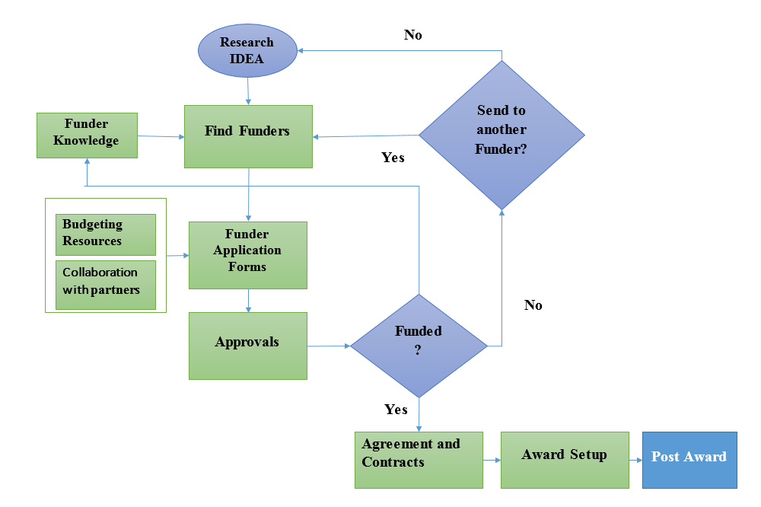
Funding Processes and Support

Slide 8
Costing a Proposal
FEC is Full Economic Cost
Directly Incurred Costs
Cost that are specific to the research project
E.g. RA costs, Travel, consumables etc.
Directly Allocated Costs
Directly allocated costs are a share of the costs of a resource used by a project, where the same resource is also used by other activities.
E.g. Investigator costs, existing facility usage costs
Estates costs
costs related to buildings and premises used
Indirect Costs
Research Organisation’s management and administrative services
RSO Website: https://www.edweb.ed.ac.uk/research-support-office/toolkit-for-applicants/costing-and-pricing

Slide 9
FEC rates
Different funders use different FEC rates
Research Councils fund 80% FEC
Industrial Funders should be costed at full FEC
Some Funders have different Rules
EC funds 100% DI cost with 25% flat rate Indirect cost
US funders differ:
NIH funds only 8% Indirect costs
Charities normally don’t fund any Estates or Indirect costs

Slide 10
Research Funding Applications
Opportunities for Early Career Researchers
Fellowships
Career Starting grants
Industrial Collaboration
Standard Grants

Slide 11
Fellowships
Focus on the researcher
Research with opportunity to develop skills
Examples
EPSRC Fellowships (Post Doctoral, Early career and Established Career)
No deadlines but panels sit twice a year
Up to 3 years for post doctoral and 5 years for early career
Royal Society University Research Fellowships
Usually in September
Royal Academy of Engineering Fellowships
Upcoming Schemes
UKRI Future Leadership Fellowship scheme- to be announced next month

Slide 12
Career Starting Grants
ERC Starting Grants
2-7 years of experience after PhD (up to Euro 1.5 Million for 5 years)
Pioneering frontier research in any field of science, engineering and scholarship
Both Researcher and the proposed research are important.
More like Fellowship than research grant
New Investigator Awards
Previously called First Grant Scheme
New academics, no experience of leading research groups
Up to three years

Slide 13
Industrial Collaboration
Work with Industry
Through projects
Through Innovate UK
Directly from Industry
KTPs (Knowledge Transfer Partnerships)
Part funded by Innovate UK and rest by a UK based Industrial organisation
Duration between 12 to 36 months
Contact your BDE and Amy Taylor Amy.Tayler@ei.ed.ac.uk in Edinburgh Innovation for KTPs and Innovate UK application

Slide 14
Standard Grants
Early Career Researchers can be:
Researcher Co-Is
Co-Investigators (if in an open ended position)

Slide 15
Any Questions?
Asad Nazir
Asad.Nazir@ed.ac.uk
Tel: 0131 650 9034

