Slide 1
Student Disability Service
Challenging Attitudes
Mainstreaming Equality

Slide 2
What is the Student Disability Service?
Team of Advisors and Admin staff: offering guidance and support
Psychologists: Educational and Clinical, carry out diagnostic assessments
Other staff include: Mental Health Mentors, SpLD Tutors, Asperger’s Mentor, Proofreaders and more
Iansyst: external company delivering AT training and loaning equipment.

Slide 3
Who do we support?
Students whose studies are affected by:
Disability
Physical health condition
Long-term MH condition
Learning difficulty
Temporary injury.

Slide 4
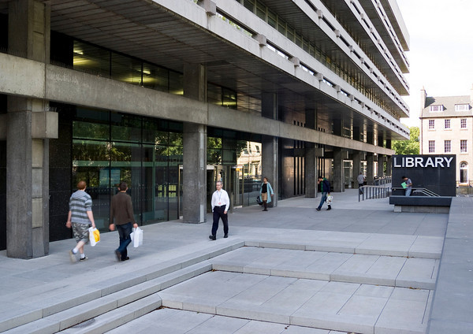
Where are we?
Student Disability Service:
Third Floor
Main Library Building
George Square
With Student Counselling
and Careers Services.
Also see students in other locations and can arrange Skype, phone or email appointments.

Slide 5
Referral process
Student must have evidence of condition
Student must have contact with an Advisor
Advisor discusses support and refers on to 1:1 specialists as required
A schedule of adjustments may also be produced and circulated.

Slide 6
What is acceptable evidence?
Current report from a Psychologist – SDS can arrange
Letter from doctor, consultant, psychiatrist etc.
Don’t need formal diagnosis, but letter must be current
Cannot accept list previous of adjustments or support
Cannot accept Counsellor’s letter
Evidence necessary for funding.

Slide 7
Wheelchair users
A wheelchair is part of a person’s space
Talk to the person, not their companion or assistant
Ask before offering assistance
Do not push a person’s wheelchair unless asked
Do not lean on a person’s wheelchair.
Notes:
Manual wheelchair with messengers in Main Library which can be borrowed by users who can self transfer if difficulties moving around library in larger electric wheelchairs
Making as many doors push button or automatic as possible
Adjustable height desks In Main Library (ground floor) and in accessible study rooms
Priority lift access in IS buildings

Slide 8
Other Mobility Impairments
May not always be obvious - not all mobility impaired people use wheelchairs
Allow for space if student uses walking aids
Ask student if they prefer to use a lift or stairs.
Notes:
Range of ergonomic keyboards and mice available in Accessible study rooms 1-4 Main Library and in some other libraries

Slide 9
Hearing Impairment
If there is an interpreter, speak to the deaf person
If student lip reads, look directly at them, speak slowly and clearly, face the light, keep hands away from your face
Written notes may help
Do not shout or exaggerate your lip movements
It’s OK to say ‘have you heard about…’
Notes:
Induction loops installed at or being installed at all library helpdesks
Induction loops in place at all desks in Main Library
Main Meeting Room on first floor Main Library has Infra red hearing system
There are portable induction loops at the reception desk on the first floor of the Main Library
The Main Library has deaf alerters at the helpdesk which can be handed out to alert students in case of fire ( we are looking into extending this to the other libraries)

Slide 10
Blind/Partially Sighted
Identify yourself and introduce others present
Offer an arm; don’t propel
Place person’s hand on the back of a chair if offering a seat
Say when you are moving away from conversation
It’s OK to say ‘have you seen……’
Notes:
Braille printers and software available in Main library accessible study room 1 and Darwin Library
Magnifiers at Main Library helpdesk looking to extend this to other libraries
Braille fire evacuation instructions available from Messengers in Main Library

Slide 11
Hidden Impairments
Pain, epilepsy, diabetes, asthma, M.E. Crohn’s disease, multiple allergies, mental health problems, eating disorders, dyslexia and many more…………
Knowing the impairment is not essential
Knowing the student’s needs is essential.

Slide 12
Specific Learning Difficulties
Dyslexia
Dyspraxia
Dyscalculia
ADD or AD(H)D
Asperger’s Syndrome, Autistic Spectrum

Slide 13
Mental Health Conditions
Team of 14 GHC staff
Mental health social workers, psychiatric nurses etc.
Study skills support in a mental health context
Appointments can be face to face, phone or Skype
Can support for duration of studies.

Slide 14
Any Questions?

Slide 15
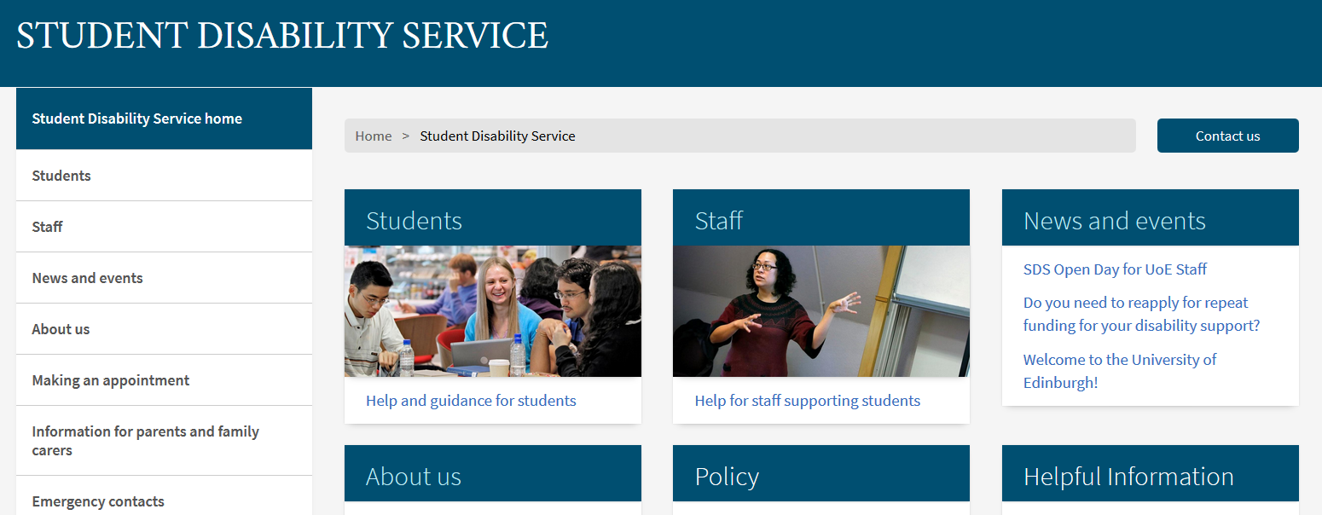
For further information
www.ed.ac.uk/student-disability-service

