Slide 1
Student Administration & Support (SA&S)
Update on future state
March 2019

Slide 2
The emerging future state of SA&S:
Brings together the work undertaken to date:
Identified current issues within Student Admin
Outlined solutions to identified issues
Changes and improvements made to Exam Timetabling, Immigration Services, Work and Study Away and Special Circumstances & Coursework Extensions
Process and People workshops
and proposes a direction of travel
It provides an overview of:
recommendations as to where SA&S functions should be led from in the future
how students will interact with the University
the expected experiential and financial benefits
how to “make it stick”

Slide 3
Upcoming work..
Student Support & Personal Tutor review
HUBs
Student Finance
Career Development

Slide 4
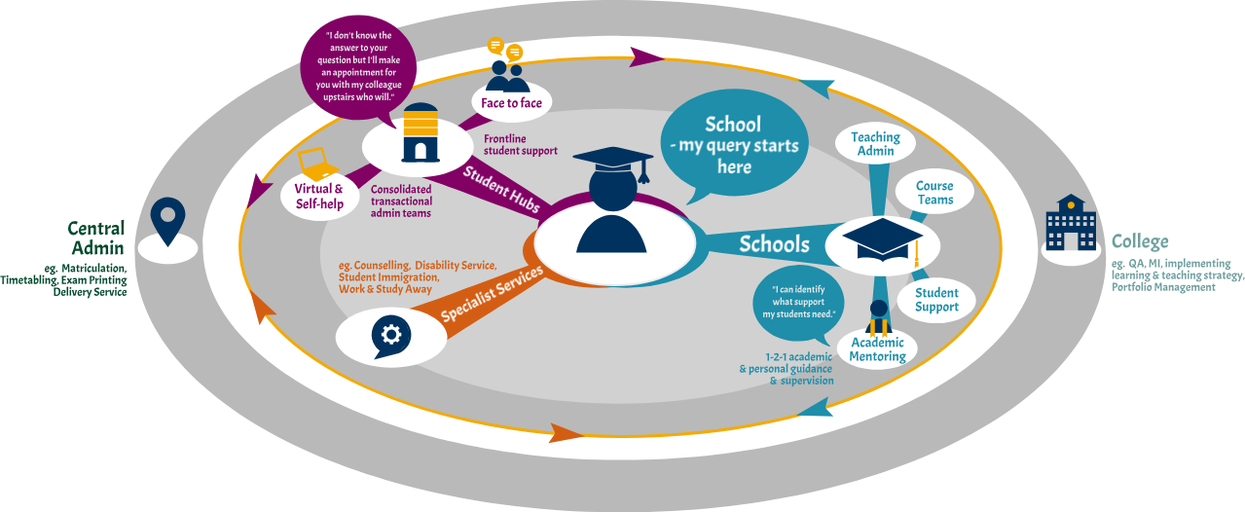
Key features of the emerging future state:

Slide 5
Key features of the emerging future state:
University Level
School and College
University Services
Special Circumstances & Coursework extensions
Timetabling (inc. exams)
Immigration
Work & Study Away
Exam Printing & Delivery services
HUBs
Student Finance
MI/BI
Matriculation
Policy, Process, System support, Training and Guidance
Appeals, Complaints & Discipline
University Student Support
Career
Counselling
Disability
Chaplaincy
School - Student Admin & Support
Student Support teams
PGR
Academic mentoring
Admin (teaching and course):
Academic Lifecycle
Course Selection
Assessment Operations
PCIM
College - Student Admin & Support
QA
Learning and teaching strategy
Key:
Projects in implementation
Change from original proposals

Slide 6
Upcoming activity:

Slide 7
Planned engagement: March - April
Date | College | Meeting
04 March | CMVM | Academic Administrators Forum
04 March | CMVM | Quality Assurance and Enhancement Committee
06 March | CMVM | Research Experience Committee
06 March | CSE | Joint meeting with TOAF and CLTC
11 March | CAHSS | SSO Forum
28 March | CAHSS | CUGLAT (UG Learning and Teaching)
13 March | CAHSS | PGR Managers Network
13 March | CMVM | UG Learning and Teaching Committee
14 March | CSE | Graduate School Administrators' Forum
14 March | CAHSS | Taught Programme Managers Forum
04 April | CMVM | PG Administrators Forum
15 May | CAHSS | CPGSC
16 May | CMVM | PG Taught Learning and Teaching Committee
TBC | CMVM | PG Business Management Group
TBC | CMVM | PGT Directors’ Forum
TBC (April) | CAHSS | Senior Tutors’ Network
TBC | CSE | College Researcher Training Committee
TBC | CSE | Senior Tutor Forum
TBC | CSE | Student Support Teams Forum

