Slide 1
Writing a Data Management Plan
Kerry Miller
Research Data Service

Slide 2
Overview
Data Management Planning
Writing a Data Management Plan (DMP)
Support for DMP & Research Data Management

Slide 3
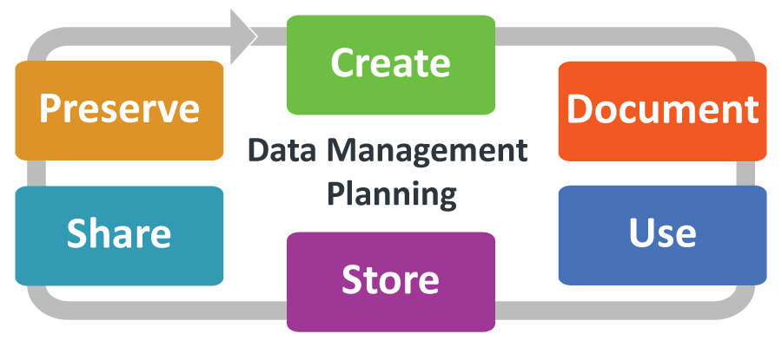
Data Management Planning
Start as you mean to go on

Slide 4
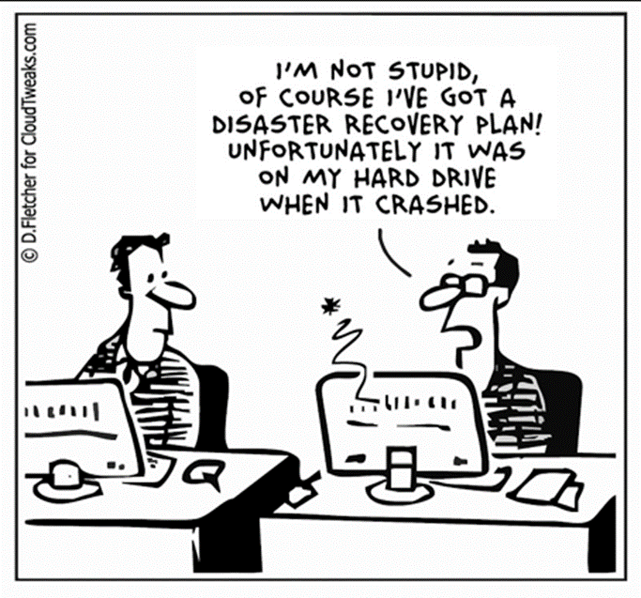
What is data management planning?
The act of planning how you will manage all aspects of your data before you begin collecting or creating it.
It may include:
Where and how you will store and back-up your data;
How and when it will be shared with collaborators;
The steps required to anonymise sensitive data;
When, how, and where your data will be preserved and shared.
Proper Preparation Prevents Poor Performance!

Slide 5
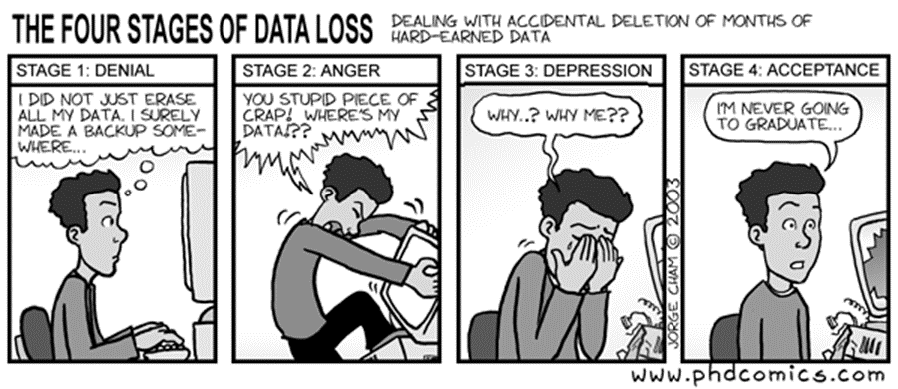
Why do I need a DMP?
To improve…
Efficiency & effectiveness;
Validation of results;
Use and/or re-use opportunities;
Visibility & impact;
The ability to share data.
To avoid…
Hardware failure;
Software glitches;
Accidental deletion / corruption;
Media degradation;
Fire, flood, or natural disaster.
Jorge Cham © http://phdcomics.com/comics/archive.php?comicid=382

Slide 6
Essential Tips
Keep your DMP short and specific;
Seek advice from within your school / institute;
Start early, don’t leave it till the last minute;
Ensure that your ethics application, DPIA, & DMP are consistent;
A DMP is a living document – keep it up-to-date;
Ensure all team members have read, understood, and agree with the DMP.

Slide 7
New Research Data Management policy
What does the policy mean for me?
You must create a data management plan (DMP) for any new research proposal.
You must include full costs for research data management in grant proposals.
You should aim to link your datasets and research outputs such as published papers using persistent identifiers such as DOIs and an ORCID.
Consider carefully who has rights to access the data; use a written agreement when necessary.
You should not give exclusive rights to data to others, such as publishers.
https://blogs.ed.ac.uk/edinburgh_open_research/2022/01/13/new-research-data-management-policy/

Slide 8
Funder requirements
Similar but different!
Use DMPonline to find the most up-to-date version of your funder’s template;
Read them carefully – answer the questions as asked;
Contact them for clarification if you are unsure;
RDS can help you complete your plan to meet specific funder requirements;
Ensure that any additional resources (money, time, equipment, staff) to deliver your DMP are included in any grant application.
Notes:
Full details of funder requirements and sample plans on: https://dmponline.ed.ac.uk

Slide 9
DPIAs and ethics applications
A good DMP will already have addressed many of the questions that are included in ethics applications and Data Protection Impact Assessments (DPIAs).
You can often reuse answers from you DMP in these forms, saving you time and effort.
DPIA templates and guidance can be found at:
https://www.ed.ac.uk/data-protection/data-protection-impact-assessments

Slide 10
DMPonline
How to use

Slide 11
Live Demo!
https://dmponline.ed.ac.uk/
Notes:
Demo steps:
Register / sign-on
Create a new plan
Show template and different guidance sets
Demonstrate sharing of the plan
Demonstrate

Slide 12
Your turn
Log-in to DMPonline
Select a University of Edinburgh template
Complete the administrative details on the first page

Slide 13
Writing a Data Management Plan
To fail to plan is to plan to fail!
Notes:
Image Rights: GC Library CC BY-NC-SA 4.0

Slide 14
What should a DMP include?
A good DMP will answer all the following questions:
What data will be collected or created?
How will the data be documented and described?
How will ethics and intellectual property be handled?
How will the data be stored, backed-up & secured?
How, when, & where will data be preserved?
How will you achieve appropriate data sharing?
Who is responsible & what will it cost?

Slide 15
1. Data Collection
Examples from funders:
Data Collection: description including type/format/ volume, methods of collection/creation, existing datasets to be used, QA processes. (UoE Templates)
The data and software outputs your research will generate (Wellcome Trust)
Outline the volume, type and content of data that will be generated… (BBSRC)
What data will you collect or create? (EPSRC)
Types of data, format and scale of data (UKRI)

Slide 16
1. Data Collection
Things to consider:
Include code and “physical” data as well as digital;
Is your digital data qualitative, quantitative, or a mixture;
Consider the data formats you will use, wherever possible choose open formats;
When using existing data outline any access requirements you’ll need to comply with;
How many files will you create and what size will each one be? Can you make a reasonable estimate of the total amount of data you’ll collect?
Don’t repeat anything already detailed in other parts of your documentation.

Slide 17
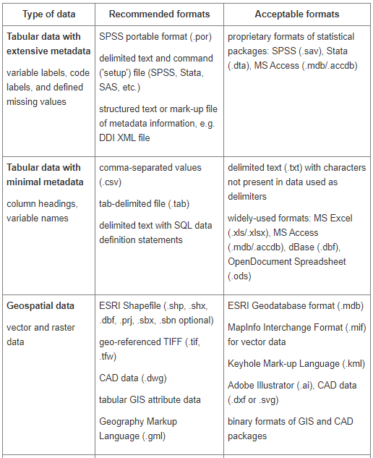
Standard file formats
Why?
Ensuring long-term usability of data requires consideration of the most appropriate software and file formats.
How?
Using standard, interchangeable or open formats for long-term preservation and popular common formats to make data available to users.
Specific recommendations:
Choose the best file formats | The University of Edinburgh https://www.ed.ac.uk/information-services/research-support/research-data-service/after/data-repository/choosing-file-formats
UK Data Service » Recommended formats https://ukdataservice.ac.uk/learning-hub/research-data-management/format-your-data/recommended-formats/

Slide 18
Writing your DMP – Section 1
Complete section 1 of the University of Edinburgh template
https://dmponline.ed.ac.uk

Slide 19
2. Documentation and Metadata
Examples from funders:
Documentation and Metadata: information needed for data to be read and interpreted in the future (and where feasible reproduced), plan for collection or creation of this documentation and metadata, any metadata standards to be used. (UoE Templates)
The formats and quality standards that will be applied to enable the data and software to be shared effectively (Wellcome Trust)
Outline the standards and methodologies that will be adopted for data collection and management, and why these have been selected (BBSRC)
What documentation and metadata will accompany the data? (EPSRC)
Methodologies for data collection / generation; Data quality and standards (UKRI)

Slide 20
2. Documentation and Metadata
Things to consider:
Where disciplinary or local standards already exist use them;
Documenting your data well will also enable you to reuse it in the future;
Do it as you go along – creating high quality documentation & metadata at the end of the project is very difficult and time consuming;
Agree things like directory structures and file naming conventions with all members of a project team – be sure any new members are trained in these;

Slide 21
Types of documentation
Varies from project to project and may include:
Data collection methodology
Code annotations, details of libraries, hardware configurations, etc
Data protection Impact Assessment (DPIA) / consent form
Transcripts
Questionnaires
Laboratory notebooks
Field notes
Standard operating procedures
Reports of decisions made that relate to conduct of the research

Slide 22
Types of metadata
Categories of metadata
Descriptive
Title
Author
abstract,
location,
keywords for discoverability
Administrative
terms of access
rights management
preservation
Structural
components of the dataset
their relationship to each other
Acknowledgement: www.tvtechnology.com

Slide 23
Writing your DMP – Section 2
Continue in DMPonline and answer the question(s) in
section 2

Slide 24
3. Ethics and Legal Compliance
Examples from funders:
Ethics and Legal Compliance: steps to be taken to protect identity of participants; steps to be taken to ensure sensitive data is stored and transferred securely; owners of the data; licences for re-use, restrictions for third party use. (UoE templates)
Any ethics approvals and consents that cover the data; reasonable limitations required for the appropriate management and exploitation of IP (Wellcome Trust)
Outline any restrictions on data sharing due to the need to protect proprietary or patentable data (BBSRC)
How will you manage any ethical issues? How will you manage copyright and Intellectual Property Rights (IPR) issues? (EPSRC)

Slide 25
3. Ethics and Legal Compliance
Things to consider:
Make explicit mention of consent, confidentiality, anonymisation and other ethical considerations, where appropriate.
Demonstrate that you have sought advice on and addressed all copyright and rights management issues that apply to the data.
Are any restrictions on data sharing required, for example to safeguard research participants or to gain appropriate intellectual property protection?
Get advice on IPR from Edinburgh Innovations at an early stage.
Also seek advice on ethics from School Ethics Committee & data protection from Data Protection.

Slide 26
What counts as sensitive data?
Data concerning human participants - This kind of sensitive data is often referred to as ‘personal data. Personal data identifies individuals, either directly (e.g. a name) or indirectly (when combined with other information to identify specific individuals).
Data relating to species of plants or animals - Data which includes information on rare or endangered species, or other conservation activities, is often classed as sensitive data.
Commercially sensitive data - Data where disclosure could cause economic harm, or prejudice the interests of any person, is deemed to be sensitive. This includes information such as references to ongoing negotiations, trade secrets, or data generated as part of a commercial funding agreement.
Data that poses a threat to others - Information which, if made available, would pose a threat to national security or would have a negative public impact.

Slide 27
Working with sensitive data
Requires particular care to avoid:
Breaking the Law!
Causing direct or indirect harm to research participants
Breaching confidentiality agreements or contractual arrangements
Damaging the researchers reputation and that of the UoE

Slide 28
Before you start
Complete the mandatory UoE training:
“Data Protection Training” (Learn)
“Data Protection Training for Research” (Learn)
“Introduction to the Information Security Essentials” (Learn)
Other relevant training:
“Working with Personal and Sensitive Data” (workshop)
Notes:
https://www.ed.ac.uk/information-services/research-support/research-data-service/training-skills/workshops-courses

Slide 29
Guidance on data security
Informatics provides extensive guidance on:
Encryption of devices and files
Creating strong passwords
Using VPNs
Securing mobile devices
Protecting sensitive data in different situations
All available on the Informatics Intranet - https://computing.help.inf.ed.ac.uk/data-security
Information Security provides guidance on:
University policy
Password managers, inc. LastPass
Secure deletion
All this and more - https://www.ed.ac.uk/infosec

Slide 30
Writing your DMP – Section 3
Continue in DMPonline and answer the question(s) in
section 3

Slide 31
4. Storage and Backup During the Project
Examples from funders:
Storage and Backup During the Project: where will live data be held ; how will files be organised/ structured and named consistently; what backup/recovery provision is there; security risks and how these will be managed, who will have access, if transferring data collected in the field, how will this be transferred safely. (UoE Templates)
How will the data be stored and backed up during the research? How will you manage access and security? (EPSRC)
Briefly describe how data will be stored, backed-up, managed and curated in the short to medium term. (UKRI)

Slide 32
4. Storage and Backup During the Project
Things to consider:
Can you use University networked storage for all your data collection and storage?
Do you have enough storage space available for all of the data you will create or generate?
If not, how will you ensure that your data is regularly synchronised between devices and properly backed-up?
Will you need to collaborate with non-UoE partners, if so how will this be done in a secure and organised manner?
Are any of your data sensitive? If so specialist storage space may need to be procured.

Slide 33
Informatics managed storage
Informatics provides AFS for most file storage. It's authenticated with load balancing, local caching, and global access.
Full details of storage options available within Informatics are here: https://computing.help.inf.ed.ac.uk/storage
Choose the solution that will best meet your needs while providing adequate security, resilience, and back-up.

Slide 34
DataStore
DataStore provides active storage for all research staff and postgrad students.
RDM DataStore provides a free ‘at point of’ use allocation (currently 0.5TB).
Additional capacity can be purchased for £175 per TB per annum.
Support for very large data (>1PB) hosting available.
This facility also provides a data services cloud for hosting specific data access mechanisms, or for integrating additional computational infrastructure.
Accessing DataStore:
http://www.ed.ac.uk/information-services/computing/desktop-personal/network-shares/

Slide 35
DataStore standard answer
"DataStore provides enterprise-class storage with guaranteed backup and resilience. Data is retained on DataStore until deletion by the data owner. The backups provide resilience in the case of accidental deletion and against incidents affecting the main DataStore storage. The data are automatically replicated to an off-site disaster recovery facility, with 10 days of file history visible online. Off-site tape backups keep 60 days of history of the filesystem. The 60 day rolling snapshots allow important data to be recovered to a prior state, by request if beyond the visible period.
Sensitive data stored on DataStore will be further protected by the use of 256 bit encryption as required by University policy"

Slide 36
OneDrive for Business
OneDrive For Business is cloud-based file storage for all staff and students as part of the Office 365 suite, allowing you to store and access personal and work files from anywhere.
Upload or sync any document from your local computer to OneDrive. It will then be available to you from any computer, tablet or phone.
Users receive 1 Terabyte (TB) of storage on OneDrive to store all personal and University documents.
Any files created in Office Online are automatically backed up in your OneDrive space.
Share and work documents with friends and colleagues both inside and outside the University (latter may require Microsoft login).
Easily recover deleted documents or roll back to previous versions.
https://www.ed.ac.uk/information-services/computing/comms-and-collab/office365/onedrive-for-business

Slide 37
Overleaf
Overleaf is a collaborative LaTeX service.
Free Overleaf Professional accounts are available for all staff and students of the University of Edinburgh.
Overleaf Professional features include real-time track changes, unlimited collaborators, and full document history.
To find out more and to sign up, visit the site: https://www.overleaf.com/edu/edinburgh

Slide 38
GitLab
Fully supported GitLab Community Edition (CE) environment for researchers.
GitLab is a version control tool which allow users to store and track changes to code and other documents.
Gitlab documentation is available at:
https://www.wiki.ed.ac.uk/display/ResearchServices/Version+Control+Service+-+GitLab
The GitLab service can be accessed at: https://git.ecdf.ed.ac.uk/
Informatics also provides a combined Git/Gerrit service
https://computing.help.inf.ed.ac.uk/git-and-gerrit-school-informatics

Slide 39
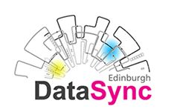
DataSync
File-hosting service for data: www.ed.ac.uk/is/datasync
Allows sharing and synchronisation of data.
Sync using local clients.
Share using local clients or web URL with colleagues anywhere.
20GB free storage or map to personal / group data on DataStore as required.
Using the ownCloud open source application.

Slide 40
Trusted Research Environments
EIDF Safe Havens
EIDF provides a range of security environments for data analysis and archive services: standard; protected data access; and safe haven. Safe havens create trusted research environments that can be tailored to meet the needs of data controllers and information governance.
https://www.ed.ac.uk/edinburgh-international-data-facility/services/safe-haven-services
NHS Research Scotland Data Safe Havens: https://www.nhsresearchscotland.org.uk/research-in-scotland/data/safe-havens
NHS Digital Safe Haven Directory (England, Wales, Scotland, & NI): https://digital.nhs.uk/services/organisation-data-service/services-provided-by-the-organisation-data-service/safe-haven-directory

Slide 41
Writing your DMP –Section 4
Continue in DMPonline and answer the question(s) in
section 4

Slide 42
5. Data Selection and Preservation
Examples from funders:
Selection and Preservation: where will the data be stored long-term? which data will be retained long-term? To ensure tha long-term preservation and storage of your data it is best to deposit it in a recognised research data repository. Think about which data you would need to validate any published outputs as well as any data that should be kept for possible future reuse. (UoE Template)
What is the long-term preservation plan for the dataset? (EPSRC)

Slide 43
5. Data Selection and Preservation
Things to consider:
Does all the data need to be preserved?
Which data are necessary to validate existing research outputs?
Where will you deposit your data for preservation? Use existing infrastructure wherever possible.
Will any of the data need to be destroyed, e.g. to protect the privacy of participants or comply with confidentiality requirements of industry partners?
What is the minimum period that the data should be preserved for?

Slide 44
How to preserve data
Document data clearly and comprehensively
Apply consistent quality assurance processes from the outset
Choose file formats that are open, and accessible
Select an appropriate repository or archive
Deposit data in the chosen repository

Slide 45
Comparison of archiving options
 | DataStore | DataShare | DataVault
Editable? | Yes | No | No
DOI | No | Yes | Yes
Cost | £175 / TB / year* 500 GB free per research user | FREE | £50 / TB / year* Free for Projects under 100 GB
Size | Depends | x < 100 GB (per dataset) | A deposit may be up to 10 TB. Vault – no limit in theory. But > 100 TB would have to be scheduled for deposit to manage queues.
Access | University login aka EASE Shared area | Open | Roles: User roles relate to a specific vault or all vaults belonging to a School.
Embargo | N/A | Temporary | N/A
* PRICES CORRECT AS AT 17 January 2022.

Slide 46
6. Data Sharing
Examples from funders:
How will you maximize data discoverability: conditions/ restrictions on sharing data; mechanism for sharing; timing of data publication; arrangements for obtaining a persistent identifier. (UoE template)
When you intend to share your data and software? Where your data and software will be made available? (Wellcome Trust)
Outline the planned mechanisms for making these data available (BBSRC)
How will you share the data? Are any restrictions on data sharing required? (EPSRC)

Slide 47
6. Data Sharing
Things to consider:
Can all your data be made openly available, or will some of it require access controls?
What will you do to promote the findability of your data?
How will you obtain a persistent identifier for your data?
Will your chosen repository record data downloads or citations?
Do you want an embargo on your data to delay its release?

Slide 48
How to make data shareable
Plan for sharing (via a data management plan) at an early stage.
Don’t collect personal information that is not needed.
Principle of informed consent: get consent to share data.
Attribute, anonymise, or aggregate individual’s data.
Document all data processing (inside & outside analysis package).
Consider the timescale for release (embargo).
Check the infrastructure for sharing.
Be aware of rights management & licensing

Slide 49
Choosing a repository
When choosing a repository consider:
Is the repository sustainable?
What will happen if the repository closes down?
How much will it cost? Are costs upfront or annual?
Will outputs be easily accessible to the researcher and to third parties?
How does the repository promote discoverability?
Does the repository record when outputs are accessed, downloaded, or cited so the researcher will get recognition for their work?

Slide 50
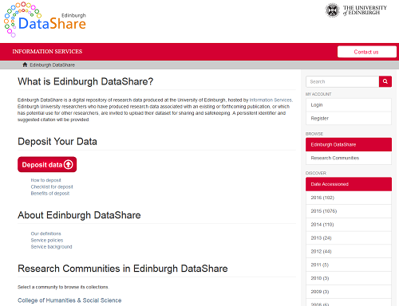
Edinburgh DataShare
Edinburgh DataShare is the University’s OA multi-disciplinary data repository hosted by the Data Library : https://datashare.ed.ac.uk
Assists researchers who want to share their data, get credit for data publication, and preserve their data for the long-term (DOI, licence, citation)
It can help researchers comply with funder requirements to preserve and share your data and complies with Edinburgh’s RDM Policy
https://datashare.ed.ac.uk
Notes:
[Edited by Pauline 23 March 2021 – new DataShare address]

Slide 51
DataVault
Safe, private, store of data that is only accessible to the data creator or her/his representative.
provides data creators with a safe place to store sensitive research data that are no longer actively being developed and cannot be published;
data will receive Digital Object Identifier(s) (DOI), which can be used in publications and other outputs;
complies with funder and University requirements to preserve research data for the long-term;
be confident that the data will be available for re-use in the future; and
links research data to metadata records in PURE.
costs £500 for 1TB over 10 years. Storage for data up to 100GB is free.
http://www.ed.ac.uk/is/research-support/datavault

Slide 52
External repositories
An external repository may be more suitable if:
The funder requires or suggests using a particular repository;
If there is an established national or international repository for the discipline;
You need to preserve and share code;
If it is necessary to implement access controls to protect the output(s).
An international register of research data repositories is maintained at www.re3data.org as part of Datacite.

Slide 53
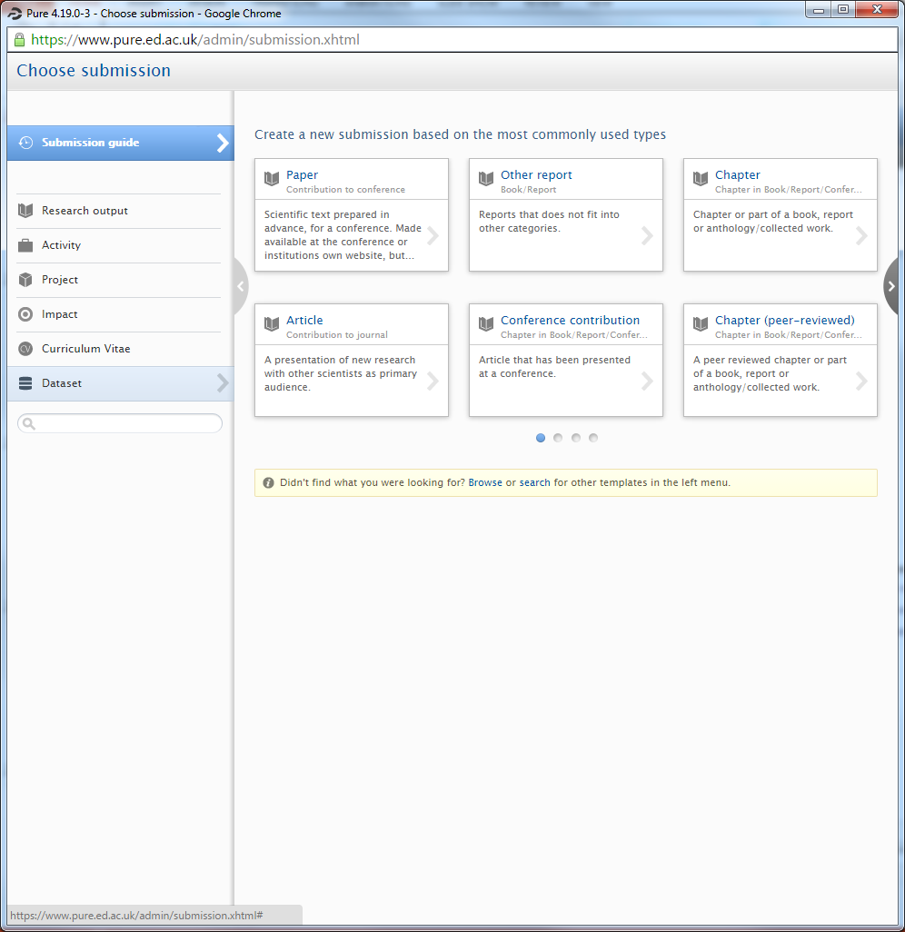
Metadata: Describing your data in PURE
You can describe your datasets (creating metadata) in PURE (datasets field):
Doing this will help your datasets to be discovered, accessed, and reused as appropriate.
https://www.ed.ac.uk/information-services/research-support/research-information-management/pure
Edinburgh Research Explorer:
https://www.research.ed.ac.uk/

Slide 54
Writing your DMP – Sections 5 & 6
Continue in DMPonline and answer the question(s)
in sections 5 & 6

Slide 55
7. Responsibilities & Resources
Examples from funders:
Responsibilities & Resources: persons involved in collection/management of data and implementing plan; training required; hardware/software requirements; charges for data repositories; costs and resources for preparation for preservation/data sharing. (UoE Template)
You should consider what resources you may need to deliver your plan and outline where dedicated resources are required. (Wellcome Trust)
Who will be responsible for data management? What resources will you require to deliver your plan? (EPSRC)
Apart from the PI, who is responsible at your organisation/within your consortia for: study-wide data management, metadata creation, data security, quality assurance of data. (UKRI)

Slide 56
7. Who is responsible & what will it cost?
Things to consider:
Outline and justify costs: what resources will you require to deliver your plan.
Include cost estimates for both active data storage and long-term preservation & storage.
Be realistic about the human time and effort required, e.g. for data cleaning or anonymisation.
Show that funds will be used efficiently and effectively.
Some funders require named individuals to take responsibility for RDM tasks – think about the best people on a team to do specific tasks
UKDA provides costing guidance: https://www.ukdataservice.ac.uk/manage-data/plan/costing

Slide 57
Writing your DMP – Section 7
Continue in DMPonline and answer the question(s) in
section 7

Slide 58
Supporting you with RDM
We’re here to help

Slide 59
Research data support
Informatics Computing Helpdesk: https://computing.help.inf.ed.ac.uk/help-desk
General RDM queries can be sent to data-support@ed.ac.uk
RDM website: http://www.ed.ac.uk/is/research-data-service
RDM blog: http://datablog.is.ed.ac.uk
RDM training at the University of Edinburgh:
www.ed.ac.uk/information-services/research-support/research-data-service/training

Slide 60
Other places to get support
Information Security: https://www.ed.ac.uk/infosec
Data Protection Office: https://www.ed.ac.uk/data-protection
Records Management: https://www.ed.ac.uk/records-management
Institute of Academic Development: https://www.ed.ac.uk/institute-academic-development/research-roles
Edinburgh Innovations: https://www.ed.ac.uk/edinburgh-innovations

Slide 61
MANTRA
MANTRA is an internationally recognized self-paced online training course developed for PGR’s and early career researchers in data management issues.
Anyone doing a research project will benefit from at least some part of the training (and you can pick and choose).
Data handling exercises with open datasets in 4 analytical packages: R, SPSS, NVivo, ArcGIS.
https://mantra.edina.ac.uk
Notes:
[Updated by Pauline 23 March 2021 – new address for MANTRA.]

Slide 62
Research Data Management & Sharing MOOC
Free online course to provide learners with an introduction to research data management and sharing.
Developed by the University of North Carolina at Chapel Hill (CRADLE project) in collaboration with EDINA at the University of Edinburgh.
Learners can obtain a certificate as an official recognition for their work.
https://www.coursera.org/learn/data-management

Slide 63
Questions?

