Slide 1
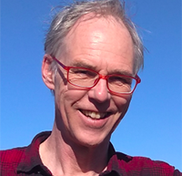
Graduate School staff and their roles – Academic Leads
Director (Nigel Topham)
Recruitment, selection, funding & scholarships (with Institute Selectors)
Graduate School policy
College and University representation
Deputy Director (Rob Van Glabeek)
Advice and on course programme support - interruptions, suspensions, extensions, annual reviews, research relationships, student experience
Networking events, transferable skills and research training courses
Student support conversations

Slide 2
Graduate School staff and their roles - PGR Personal Tutors
For all MScR and PhD students, we have PGR tutors - John Longley, Murray Cole and Elizabeth Polgreen
Independent academic advisors who can be consulted in case of difficulties that cannot be resolved through normal supervisory mechanism
Can offer advice on certain issues that students may not want / be able to discuss with their supervisor
Liaison with the Deputy Director of the Informatics Graduate School (Rob)
Students may request a consultation with either male or female Personal Tutor if they have a gender preference
The CDTs have specific pastoral support tutors (Bjorn Ross for NLP, Michael Herrmann for RAS, Ian Simpson and Diego Oyarzun for Biomed-AI).
Tutors may provide direct support or signpost students to various forms of non-academic support, such as the wellbeing centre/advisors, student counselling service, disability service.

Slide 3
Graduate School staff and their roles – IGS admin team
Lindsey Fox (Manager)
Team management
Policy, procedure, regulations
Finances/budgets
Agapi Stylianidou and Kat Deuchars La Fleur
Admissions and pre-arrival support
Patrick Hudson and Jonathan McBride
on course programme support (programme changes, concessions,
student wellbeing support (including SoA support)
Socials and community building
estates management (desks / office admin)
Agapi Stylianidou and Margaret Blake
Stipend payments and funding admin
Located on level 3
Office 3.42
Drop in between
09.30-12.30
2 – 4pm
Email
igs@inf.ed.ac.uk

Slide 4
Academic Training and Support
Getting Started with Postgraduate Research Course
A three week online course for all new PGR students
Next course will run from 16 Oct 2023 (3 x sessions across 3 weeks)
Structure:
Week 1: Getting to know you and starting out – this is to introduce you to the course and other participants and to cover the essential information and expectations
Week 2: Focus on achieving the first milestones – identifying milestones, planning and skills development, the supervisory relationship
Week 3: Overcoming common challenges – identifying challenges, tips and strategies to overcome
BOOK ONLINE https://www.ed.ac.uk/institute-academic-development/postgraduate/doctoral/courses/getting-started-postgraduate-research

Slide 5
Academic Training and Support
A dedicated academic service providing tailored support and opportunities for UG, Masters and Doctoral students, and for early career researchers and staff involved in teaching, learning and research.
They provide support to help you identify and gain skills needed to successfully complete your research degree
But they also support doctoral researchers by focusing on the researcher beyond the research degree
They provide information and support to help you take responsibility for your own professional and skills development.
A great place to start (and revisit) is the VITAE Research Development Planner….

Slide 6
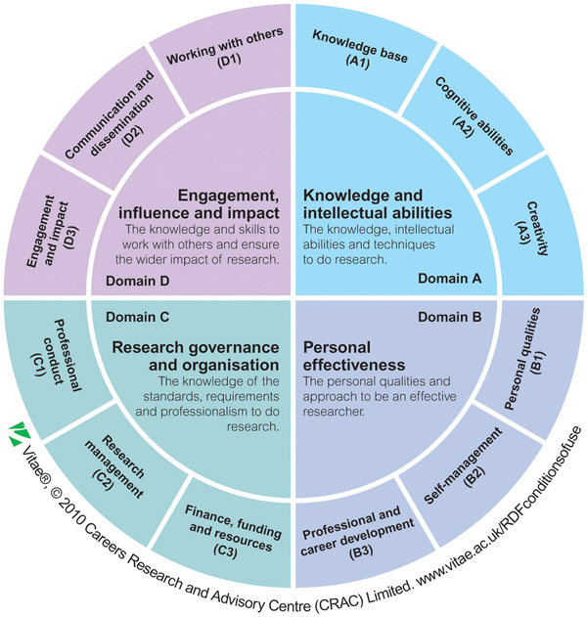
Academic Training and Support
Use the Vitae Researcher Development Framework (RDF) to help you:
explore all the aspects of being a researcher
identify your strengths
prioritise areas for professional development
write a plan, then monitor progress and success
have productive discussions with others, e.g. your supervisor, careers advisor etc
look for formal and informal development opportunities
prepare for one-to-one progress reviews, appraisals or career development conversations with your research manager or mentor.
REVIEW REGULARLY / ANNUALLY

Slide 7
Academic Training and Support
The IAD offers a large number of (in person and online) training workshops linked to the RDF planner
Domain A
Good Practice in Research Data Management
Viva Survivor
Designing effective conference posters
Domain B
Managing your research project
Practical project management
Public speaking, networking and engaging
Presenting with ease
Writing retreats
Domain C
How to be an effective researcher
Research Ethics and Integrity (compulsory for UKRI funded students)
Domain D
Writing for publication
Social media for research and impact
Public engagement beyond lectures

Slide 8
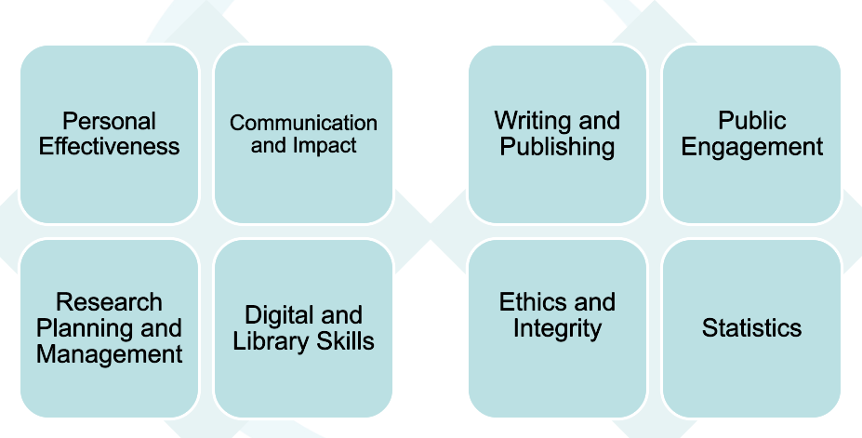
Academic Training and Support
Also dedicated courses for those who are interested in Tutoring and Demonstrating to supplement income and an interest in academic teaching
BOOK ONLINE https://www.ed.ac.uk/institute-academic-development/postgraduate/doctoral/courses

Slide 9
In case of problems
https://web.inf.ed.ac.uk/infweb/student-services/igs/phd/resolving-problems
Points of contact depend on the kind of issue (and who it may involve)
Your Principal Supervisor
Your Assistant Supervisor(s)
Your Institute or CDT Director, or CDT tutor
Head of Graduate School
Nigel Topham
Personal Tutors for Research Students
John Longley
Murray Cole
Elizabeth Polgreen
Deputy Director of Graduate School – Rob Van Glabeek
Head of School (Helen Hastie)
College Dean of PGR Students (Anthony Maciocia)
Normal points of contact are for general guidance
If you have a sensitive issue to discuss you can contact any of the above, but we recommend talking first to Deputy Head of Graduate School or a Personal Tutor
Normal Point of Contact for Academic Issues .
Degree Programme Issues .
Admissions or Studentship Issues .
Any Other Issues .
Escalating Unresolved Issues .

Slide 10
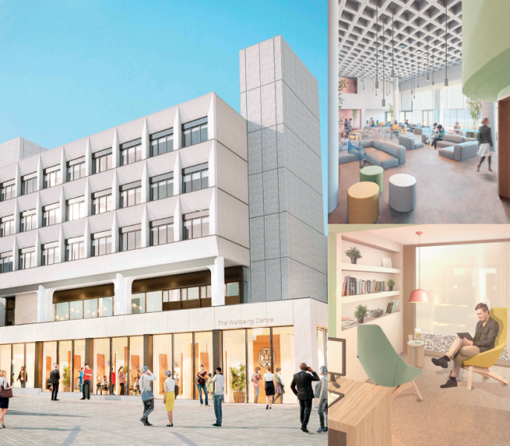
University Central Services
Health and Wellbeing Service
University NHS GP practice / pharmacy in Bristo Square
The University Counselling Service
Supporting the mental health of students, using short-term counselling (face to face and email). You can "self-refer" and priority is early intervention.
Drop-in sessions and lifelong learning
Referral to other services
Self-help links and links to online apps
Big White Wall
Free access to the Feeling Good App
Silver cloud (online mental health treatments/CBT)
Crisis support
University Disability Service
Needs assessments and schedule of adjustments
University Libraries
The Advice Place (EUSA)
They provide advice to students on everything from getting grades appealed, dealing with landlord issues, to managing personal issues and much more.
Careers service
The Wellbeing Centre houses the Student Counselling and Disability Services, the University Medical Centre and the University Pharmacy.

Slide 11
Programme Concessions
There are a range of concessions and leave entitlements for PGR students:
Leave of Absences → any study needing to be undertaken off-campus requires you to apply for an LoA.
Interruptions → student can apply for an Interruption from their programme of study if / when a break might be required.
Changing programme → (rare) but it is possible to change your programme of study to a lower / exit degree if it is appropriate.
Extensions → possible, but only with good reason/justification and with support of supervisor and the IGS (approval is not guaranteed / an automatic right)

Slide 12
PGR Leave Entitlements
Leave Entitlements – Annual leave, compassionate leave, sick leave, parental leave
Annual leave - 40 days for all FT students (pro rata for PT students), which includes the days students must take over Christmas closure period (NB: CDT students must not take AL during the teaching semesters)
Compassionate leave – students funded by a studentship administered by the Uni/School are entitled to 5 days compassionate leave in any rolling 12 month period; clear application process on IGS webpages.
Sick leave – students funded by a studentship administered by the Uni/School are entitled to 3 months sick pay in any rolling 12 month period; clear application process on IGS webpages, must be support by a Fit Note from your GP if sickness absence >7 days.
Parental leave - students funded by a studentship administered by the Uni/School are entitled to paid maternity, paternity and/or adoption leave (in line with statutory provisions).

Slide 13
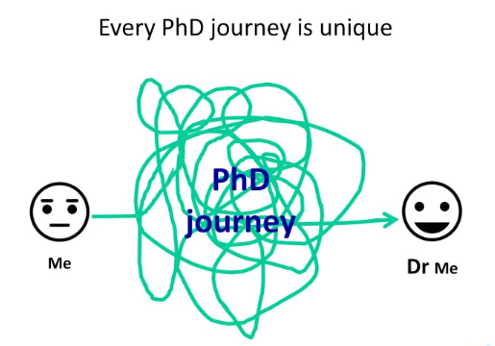
Words of wisdom
Expect the unexpected; plans and opportunities change.
Be adaptable and resilient. Adopt to changing situations and be prepared to bounce back.
Look after yourself and your mental wellbeing. Ask for help as soon as you need it; don’t delay as being happy and healthy is integral to excelling in your research and being a productive/successful researcher.

