Slide 1
Teaching Support Provider Roles
Ionela G. Mocanu (PhD Student)
TA: INF2-IADS
Tutor/Marker: DMP, INF2B, INF2D

Slide 2
Step 1: Applicant Information (CV)
A. Eligibility
B. Skills and Experience
Fill out Teaching Support Applicant Information Form
PGR allowed to take any TSP role

Slide 3
Step 1: Applicant Information Form
Step 1.A. Eligibility
Further information for students on Tier 4 study (max 20h/week)
Requires NINO (get one from HMRC)
You must be in UK (Health Insurance)

Slide 4
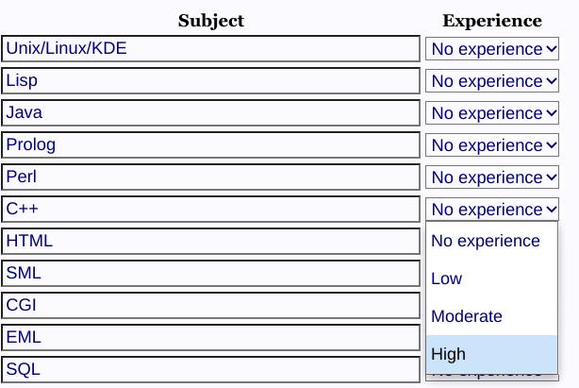
Step 1: Applicant Information Form
Step 1.B. Skills and Experience
Assess yourself honestly
Lecturers will use the form (CV) to interview or select candidates

Slide 5
Step 2: Documents Verification
Email teaching-support@inf.ed.ac.uk scans of the:
Current and Valid Passport
Recently Expired Passport (UK Nationals)
EU National ID Card (EU Nationals)
Visa/Other Supporting Documentation (non-UK citizen)
NINO appointment letter (if not provided in Applicant Information Form)
Arrange a video call with ISS Room (confirm your identity)

Slide 6
Step 3: Vacancies
Check vacancies roles at: Live Theon Vacancies
Read description for each role
Check availability [¾ = 3 assigned roles out of total of 4]
Teaching Support Provider Policy

Slide 7
Step 4: Roles Application
Fill out Teaching Support Application for Work
The weekly average over the academic year is not more than 9 hours
Tier 4 study visas (extra: maximum of 20h in any given week)
Reviewing applications - up to 2 weeks

Slide 8
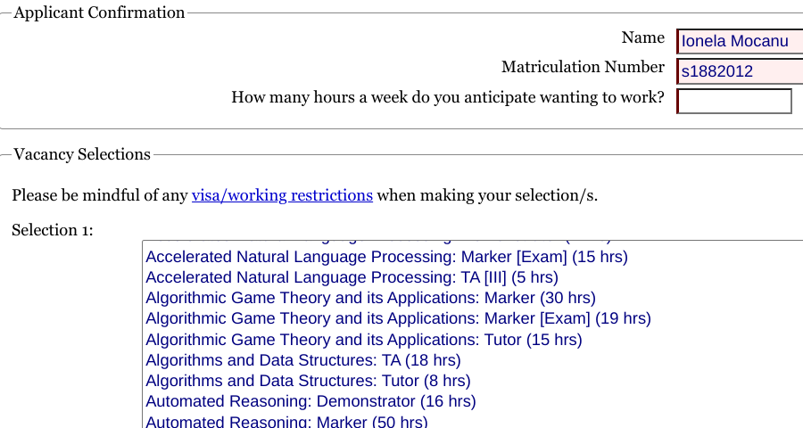
Step 4: Roles Application

Slide 9
Step 5: Networking
Contact the lecturer regarding the role
Know the role expectations
The contract:
Guaranteed hours contract (specific paid #hrs)
Make note of tutorials days and time (weekly)
Make note of conference and journals deadlines (Markers)

Slide 10
Step 6: Training via Learn (paid)
Can be done before receiving the contract
‘Essentials ’ training - compulsory
‘Basics of Online Learning Environments’ - compulsory
‘ Advanced Sessions’ - optional
Self-Enrol in Training: instructions
Synchronously or Asynchronously
Teaching Support Trainer: Cristina - Adriana Alexandru

Slide 11
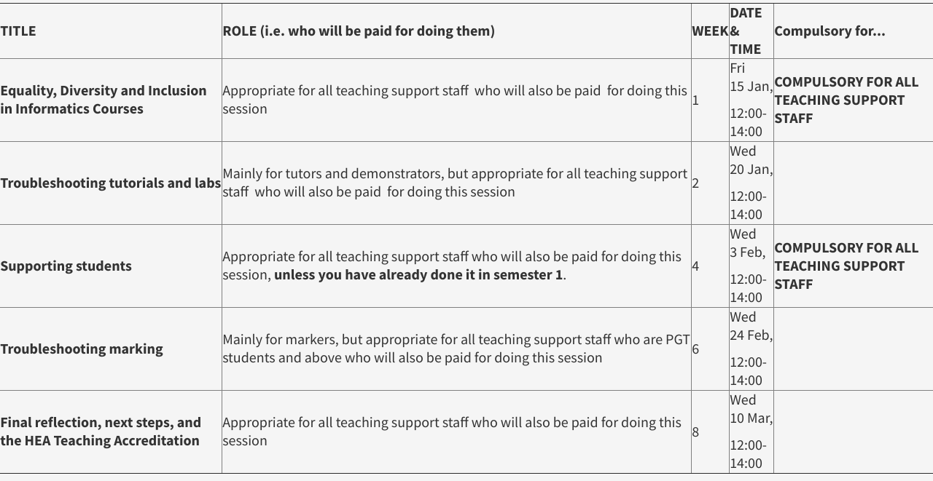
Step 6: Training via Learn Semester 2

Slide 12
Your Teaching Support Role
Submit the timesheet WEEKLY (payment at the end of month)
Tutors - solve the exercises first without solutions
Get to know the students (via M.Teams)
Students don’t want to attend over time
Marker - track the time, do not work more than #hrs assigned
Contact course organiser immediately if that happens
(eligible for Edinburgh Teaching Award, HEA accreditation)

