Slide 1
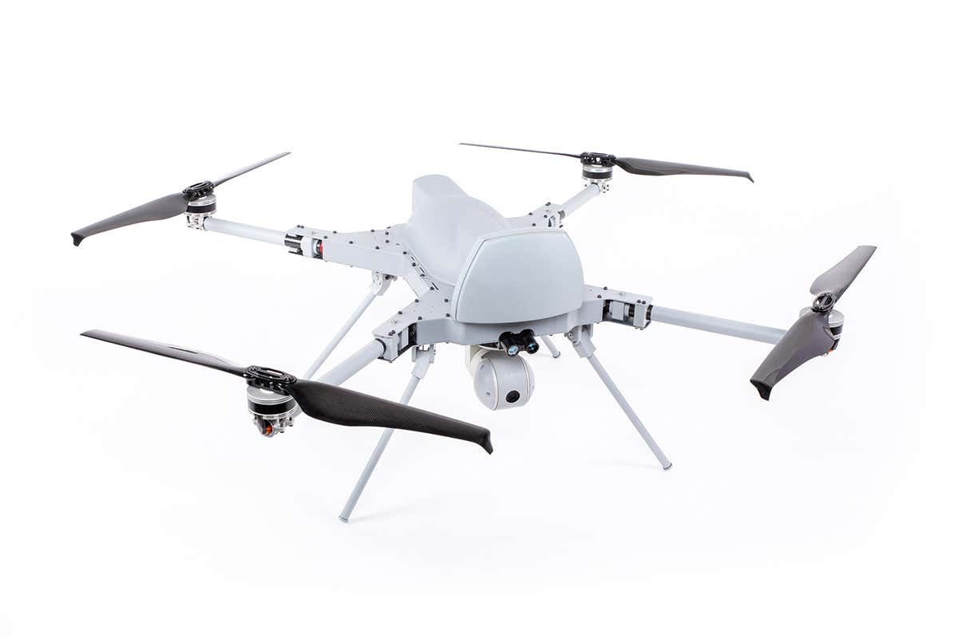
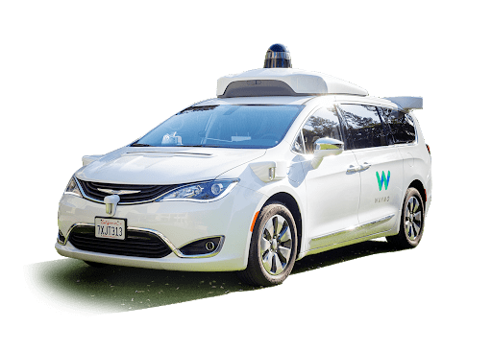
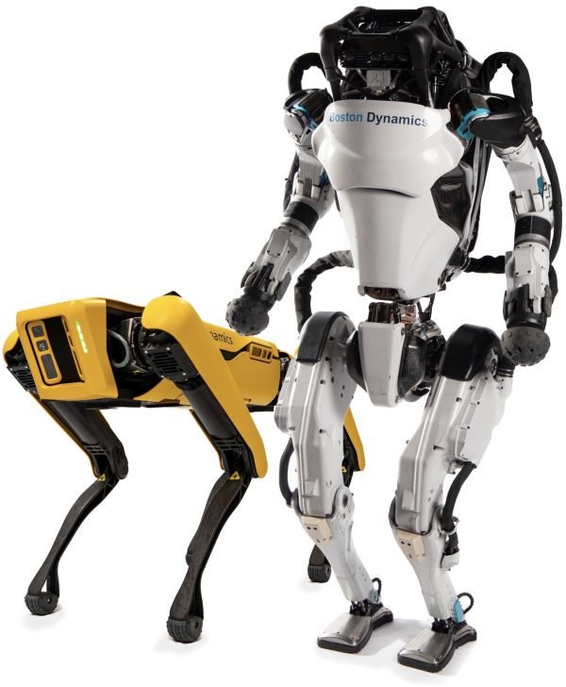

Robotics
Chris Xiaoxuan Lu
Lecturer in Cyber Physical Systems

Slide 2
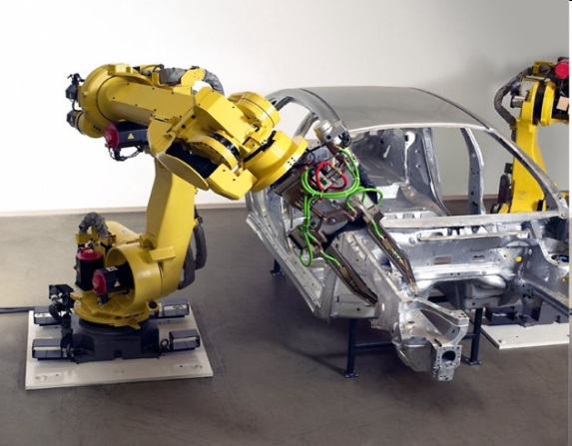
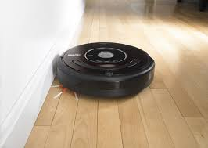
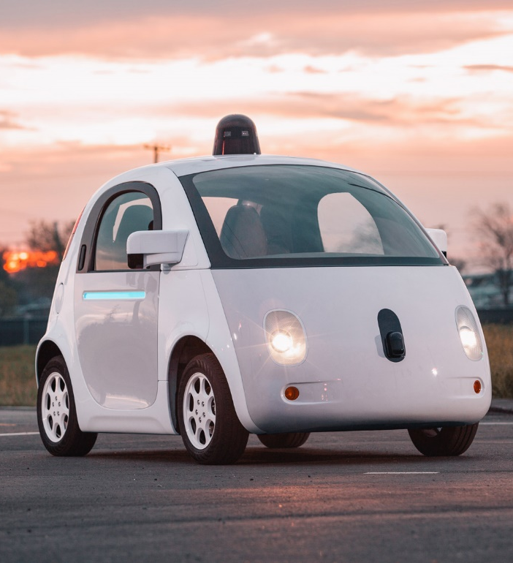
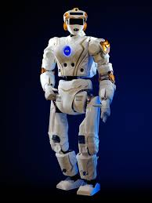

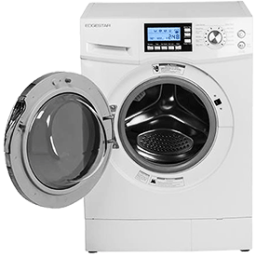
What is a robot?
An intelligent machine that interacts with the world autonomously

Slide 3
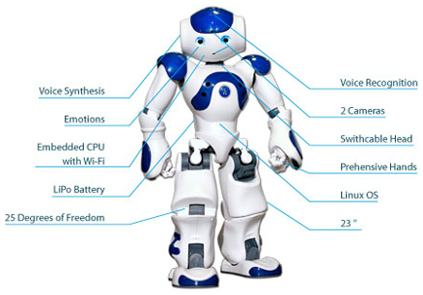
- Sensory components: Acquisition of information
- Actuator and effector: Realization of actions and behaviour
- Information processing and control: Processing of sensory signals, memory, planning and evaluation
- Accessory components: battery, interface, communication modules etc.
What constitute a robot?
Components
Source: https://www.javatpoint.com/components-of-robot

Slide 4
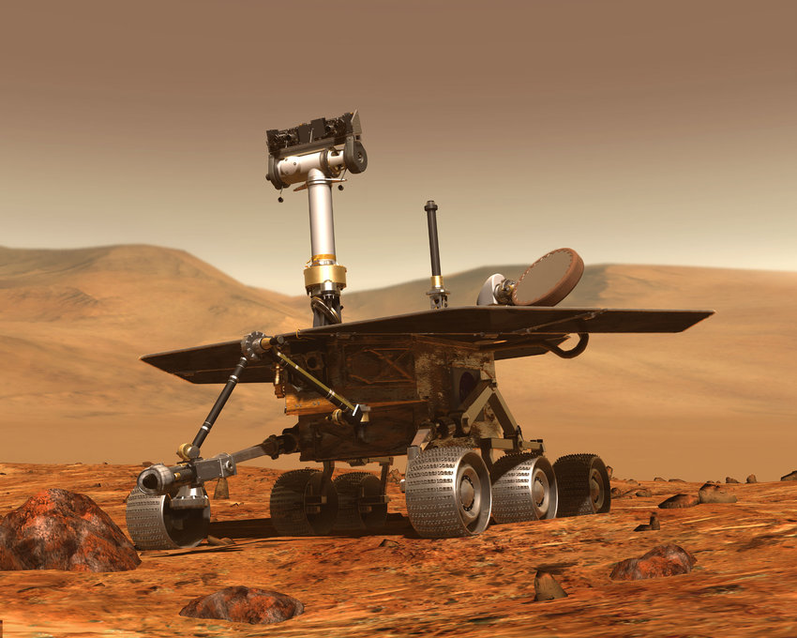
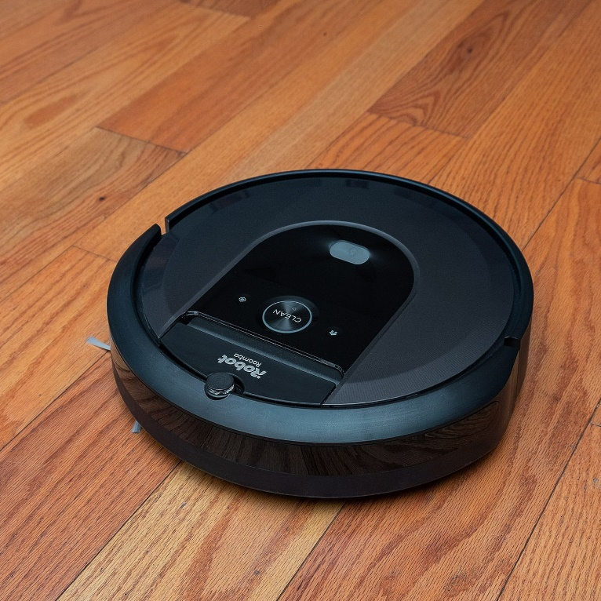
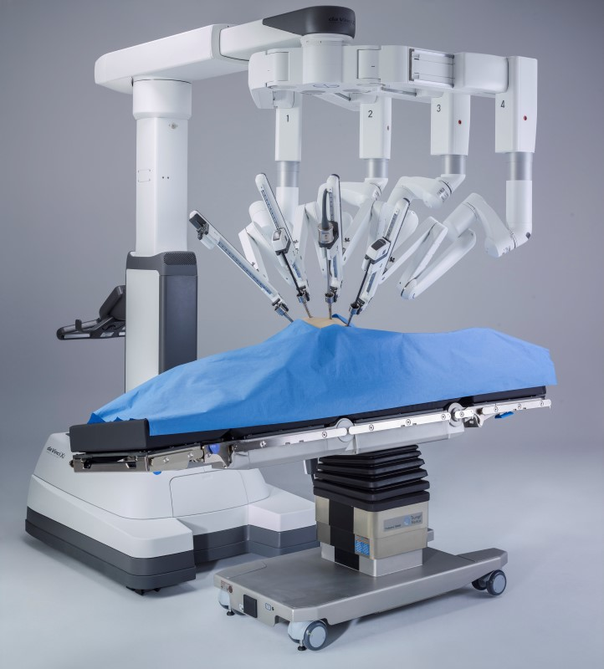
Why do we need robots?
Use Cases:
Dangerous: exploration, chemical spill cleanup, disarming bombs, disaster cleanup
Boring and/or repetitive: cleaning, welding car frames, part pick and chores.
High precision or high speed: Electronics testing, Surgery, precision machining.
Exploration
Cleaning
Surgery

Slide 5
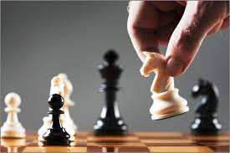
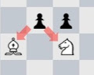
What is the challenge in robotics?
An intelligent machine that interacts with the world autonomously
The easy bit
The hard bit

Slide 6
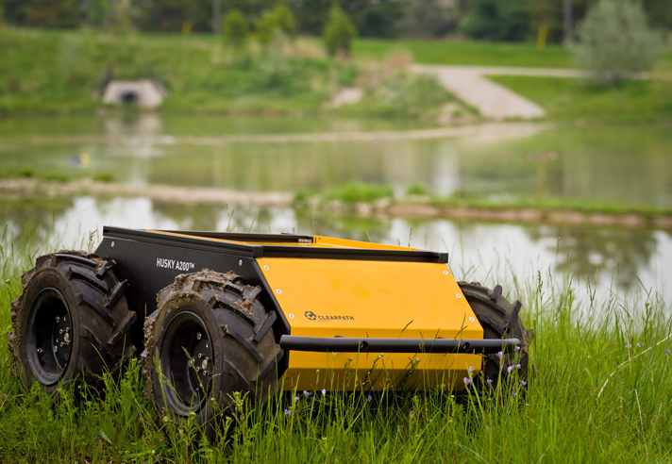
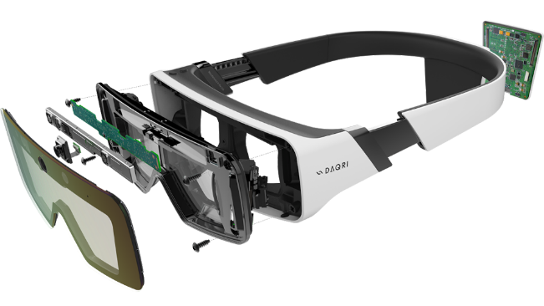
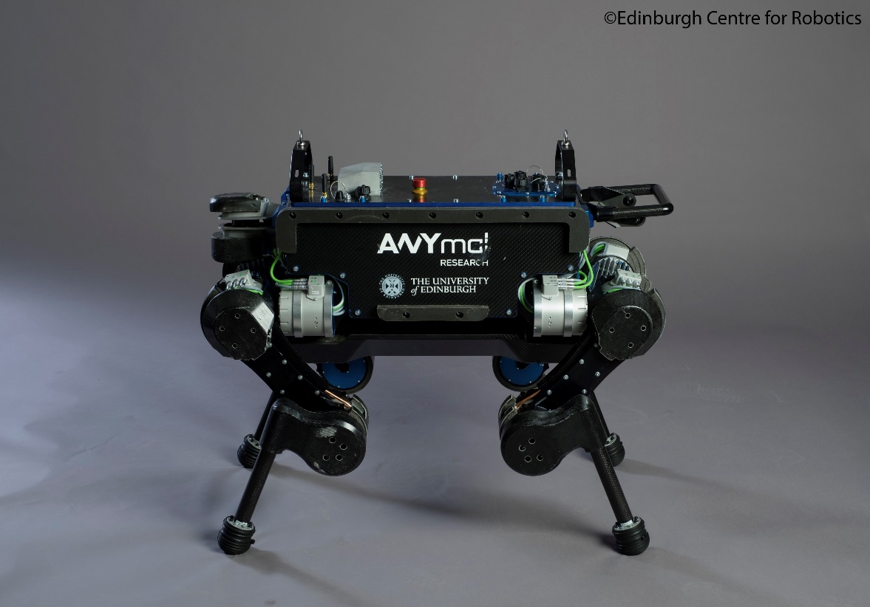
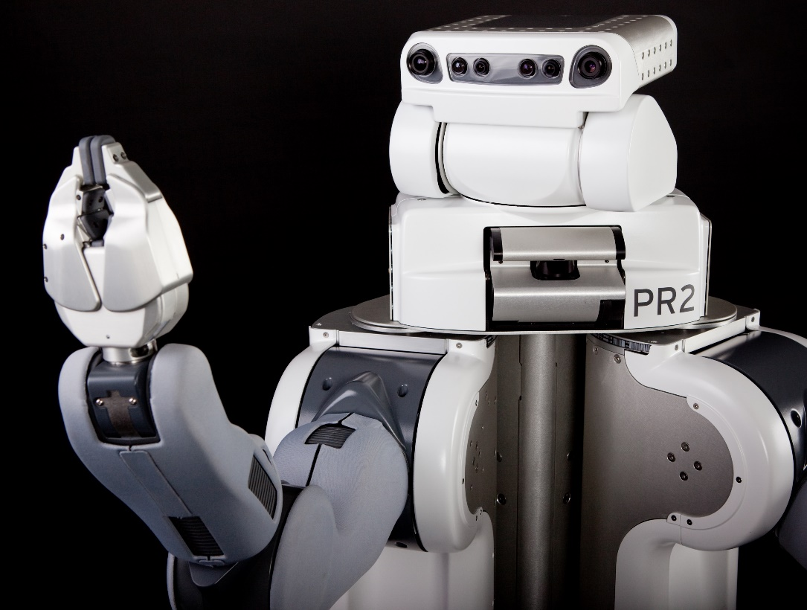
Robotics at Edinburgh
Smart Interface
Indoor/Outdoor navigation
Bio-inspired robotics
Human-robot interaction

Slide 7
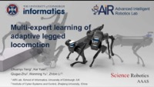
Auto Recover – Dr. Alex Li (PI of AiR Lab)
https://groups.inf.ed.ac.uk/advr/

Slide 8
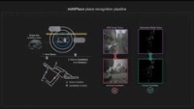
Autonomous Driving – Dr. Chris Lu

Slide 9
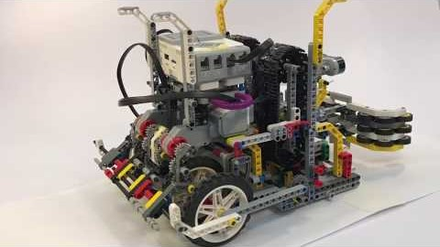
Robotics in your degree
Year 3
Introduction to mobile robotics
System Design Project
– theme is assistive robotics
Year 4/5
Individual project – many robot research topics available
Advanced vision
Decision making in robots and autonomous agents
Robot learning and sensorimotor control
…
https://youtu.be/NOlHltppxJ8

Slide 10
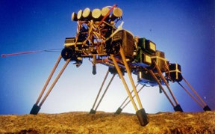
Year 1&2 Foundations
Computation: Logic and finite state machines
beta
force
beta
balance
i
pitch
feelers
s
d
alpha collide
up leg trigger
walk
i
s
beta
pos
alpha advance
leg down
prowl
alpha balance
s
alpha
pos
IR sensors
steer

Slide 11
Year 1&2 Foundations
Data: how can you extract the right information, quickly and reliably, from the sensor data stream?
Learn words by assigning to clusters in feature space from many example regions
Convert to discrete representation

Slide 12

Maths: Probability
Year 1&2 Foundations
E.g. what is the probability distribution of the sensor reading from a range sensor, given the wall distance?
Possible sources of error:
Noise in the actual distance measure
Person passing
Random measurements
Maximum range measurements
Bayes Theorem
P(x,m|z) = P(z|x,m)P(x,m)/P(z)

Slide 13
Year 1&2 Foundations
Maths: Calculus
E.g. control robot by establishing appropriate oscillatory dynamics
v_{i} intrinsic frequency, R_{i} intrinsic amplitude, a_{i} positive constant
w_{ij} and ϕ_{ij} determine coupling
Left - right

Slide 14

The challenge remains open…
https://youtu.be/NeFkrwagYfc

